Slide 1



Fall 2024 NHSDC Conference: Harvesting Connections
Witchcraft or Wizardry?
AI’s Magic in Social Workflows
NHSDC Conference Reminders:
For everyone to get a chair:
Please sit in the center of your row.
Please do not leave empty seats between people.
If asked, please help people find empty seats.
Please use the microphone when asking a question.
Have questions or concerns, please ask the staff at the check-in desk.
Notes:
Water, bathroom, camera, music.
***END OF NOTE***

Slide 2

GAITHER DYNAMIC
CEO
CHARLOTTE COUNTY
HOMELESS COALITION
Board Member
COC ALLIANCE
Founder
Hello!
I am Gaither Stephens
You can contact me at Gaither.Stephens@GaitherDyn.com
Notes:
Thank you all for joining me today and a special thanks to the FCEH for inviting me back! I began my work in homelessness right here in Florida, so this state and this conference hold a special place in my heart. Also, there are many wonderful people at the FCEH. If you have the opportunity, I highly recommend getting to know them and learning about the great work they do.
I understand we all have tasks looming in the background, so if you need to attend to other work while you're here, please feel free to do so. Time is a valuable resource, and I respect that.
Before we get started, by a show of hands, how many people in the audience have experience using some sort of Artificial Intelligence, or AI, like ChatGPT?"
***END OF NOTE***

Slide 3
AGENDA
The RISE of AI
Assistant, Not Overlord
AI: THE BAD
Pitfalls and Challenges with Existing AI
The End Questions/Thank You/Contact
The Early Build
Gaither’s Journey from Code to Compassion
1
3
5
7
0
2
4
6
WELCOME
(YOU ARE HERE)
Stretched to the Limit
The Strain on Social Services
AI: THE GOOD
Revolutionizing Resource Management
AI: THE UGLY
When Good AI Goes Wrong
Notes:
Let's take a quick look at what we'll be covering today:
First, we'll start with 'The Early Build,' where I'll share my journey from code to compassion.
Following that, we'll explore the impact and potential of Artificial Intelligence in our session titled 'The Rise of AI – Assistant, Not Overlord.'
We'll then discuss the current strains on social services in 'Stretched to the Limit.'
Midway through, we'll examine how AI is transforming resource management in 'AI: The Good.'
We'll address the challenges and pitfalls of existing AI systems in 'AI: The Bad.'
And we'll conclude our AI discussion with 'AI: The Ugly,' where we'll consider what happens when good AI goes wrong.”
Lastly, we’ll cover questions and comments!
Let’s begin!
***END OF NOTE***

Slide 4

1
The Early Build:
Gaither’s Journey from Code to Compassion
Background, Education, & Experience
Notes:
I’m going to take a few moments during this next section to introduce myself, tell you a little bit about my journey through life, how it’s shaped my work and passions, and how my experiences and insights might benefit you!
***END OF NOTE***

Slide 5
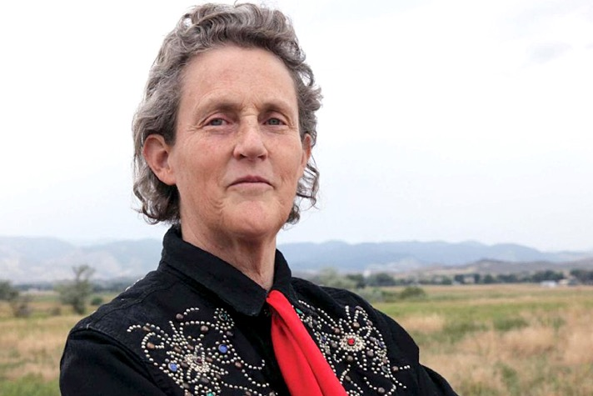
“I am Different, Not less.”
–Temple Grandin
Notes:
You may or may not know about Temple Grandin, but she’s one of the most influential figures in both animal science and the humane treatment of livestock. Her groundbreaking work in designing livestock handling facilities revolutionized the industry, with over half the cattle in the U.S. being processed through systems she designed. Grandin’s ability to think visually allowed her to see the world from an animal's perspective, creating innovations that reduced stress for animals and improved efficiency. She’s also a professor, a best-selling author, and an advocate for hands-on education. And while it’s not the most important thing about her, many people are surprised to find out that she has autism. Finally, as many of you may or may not know, I am also on the autism spectrum, just like Temple Grandin!
***END OF NOTE***

Slide 6

8 Common Challenges of Autism:
Sensory Overload
Social Challenges
Communication Barriers
Repetitive Behaviors
Stubbornness
Anxiety and Stress
Concrete Thinking
Executive Function Issues
Notes:
Having autism can lead to many challenges including:
Sensory Overload
Social Challenges
Communication Barriers
Repetitive Behaviors
Stubbornness
Anxiety and Stress
Concrete Thinking
Executive Function Issues
***END OF NOTE***

Slide 7

8 Ways TO EXCEL WITH Autism:
Sensory Awareness
Social Independence
Direct Communication
Mastery Through Focus
Relentless Perseverance
Preparation and Detail
Practical Solutions
Structured Efficiency
Notes:
Now that we’ve covered some common challenges faced by individuals on the autism spectrum, let’s explore how perceived setbacks can actually be powerful assets. Take Temple Grandin, for instance, whose acute sensory sensitivity not only posed challenges but also became a gateway to understanding animal emotions. This insight led her to design revolutionary livestock handling systems that significantly reduce stress. Her disregard for social norms allowed her to present bold, innovative ideas without fear of judgment. Her straightforward thinking made complex ideas accessible and easy to communicate. Her ability to focus intensely on repetitive tasks enabled her to perfect her designs, using repetition as a tool for mastery. This same stubbornness, often viewed as a flaw, fueled her perseverance to complete projects, while her anxiety translated into meticulous planning, ensuring every detail was accounted for. Temple’s practical, visual thinking helped her develop clear, actionable solutions in animal welfare. Despite organizational challenges, she established strong routines and strategies that enhanced her productivity and advanced her goals. Each transformation illustrates how what might initially appear as a disadvantage can, in fact, become a key asset that drives innovation and success.
***END OF NOTE***

Slide 8
8 Fun facts about Gaither:
Earned $1 million by 30s
AS, BS, & MS degrees
Founder of CoC Alliance
Managed 5 radio stations
GM, RM, CTO, & CEO
National expert & speaker
Husband & father
Drummer, artist, traveler
Notes:
Much like Temple Grandin, I too have navigated challenges stemming from my disabilities, including autism spectrum disorder. These challenges, however, have not prevented me from reaching significant milestones. By the age of 37, I had earned over $1 million. I hold three college degrees, have founded the CoC Alliance, and my extensive experience in radio leadership, along with roles as GM, RM, CTO, and CEO, as well as being a national expert and speaker, husband, father, drummer, artist, and traveler, all reflect my journey of overcoming obstacles and achieving my goals.
This journey underscores that having disabilities does not mean one is disabled. I've thrived by recognizing my unique needs and devising ways to meet them, even in the face of scarce resources and disadvantages. This principle is equally applicable to social service agencies, which often encounter resource gaps that hamper their effectiveness. By embracing strategies of adaptation and resource management, we can significantly enhance the impact of social services.
Now, let's explore how we can extend these strategies more broadly.
***END OF NOTE***

Slide 9
STRETCHED TO THE LIMIT:
THE STRAIN ON SOCIAL SERVICES
2
Adversity, Advocacy, & Advancement
Notes:
In this next section we’re going to talk about challenges in social services and I’m going to offer modern strategies to tackle these challenges.
***END OF NOTE***

Slide 10
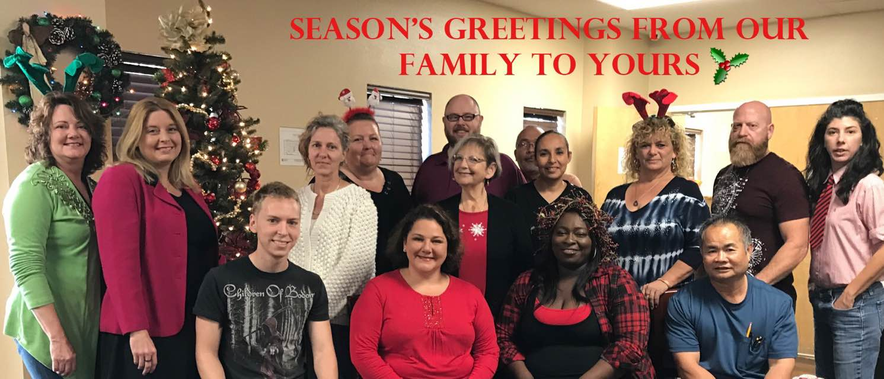
2016 Staff Christmas photo
Charlotte County Homeless Coalition
Notes:
In 2016, I joined the Charlotte County Homeless Coalition as a data analyst, and it was an eye-opener—I truly had no idea what I was stepping into! As a side note, the turnover at the organization was so high that none of the individuals in this picture are still with the organization.
***END OF NOTE***

Slide 11

8 Challenges faced in social services
Multiple Hats
CTO, Marketing Director, IT, Training, Support, PIT, HIC, SysPM, LSA, Veteran & Chronic Committee Meetings Leader, etc.
Outdated System
Exchange 2007 server that only allowed email use within the physical building and the server hard drive was constantly getting full.
Security Issues
Every user in system had Sys Admin II highest level security access, including an account shared by 18 volunteers at a local church.
Incorrect Setup
Every project was set up as the top project meaning there was no hierarchy in our system, just a large forest with individual trees.
Data Quality
The system had false data, poor data, and missing data. Data quality was an ‘F’ across the board making reports completely unreliable.
Lost Revenue
Previous data analyst missed NOFA deadline and lost $200,000 in HUD funding for the Continuum of Care.
Notes:
In my multifaceted role within social services, I juggled responsibilities from CTO to Marketing Director and more, all while managing an outdated Exchange 2007 server and security vulnerabilities due to excessive access permissions. Our systems lacked clear organization, data integrity was compromised with inaccuracies, and we faced a significant setback with the loss of $200,000 in HUD funding due to an oversight (just before my arrival). These challenges underscore the pressing need for improved resource management and operational efficiency in the sector.
**END OF NOTE***

Slide 12

The Persistent Problem of Homelessness in the United States
As of 2024, there were over 380 Continuums of Care competing for an insufficient amount of federal dollars to end homelessness for over 650,000 people across the United States.
Notes:
As we turn our attention to this slide, it's crucial to acknowledge the ongoing challenge of social services, particularly homelessness social services. Despite the efforts of over 380 organizations across the nation competing to coordinate the national homeless response, the reality is that as of 2024, the federal funds available were simply not enough to support the over 650,000 Americans in dire need of housing. This underscores a persistent gap between our aspirations and the resources allocated, and it’s only getting worse.
***END OF NOTE***
https://endhomelessness.org/homelessness-in-america/homelessness-statistics/state-of-homelessness/

Slide 13


~$26 billion
Cost to end homelessness
~$10 billion
Amount dedicated in 2024
~$16 billion
Annual deficit
Notes:
Back in 2012, Mark Johnston, then with HUD, gave a best guess at the dollar amount needed to end homelessness in the United States and he suggested $20 billion, about $26 billion today with inflation. It’s widely accepted that this number is very much on the low side.
In 2024 congress put aside roughly $10 billion towards homelessness.
Even with a conservative estimate, we are easily seeing over a $16 billion deficit each year in spending. How could we ever make up this deficit? Do we even have this kind of money as a country? Let’s find out!
***END OF NOTE***
https://www.verifythis.com/article/news/verify/social-justice/20-billion-not-enough-eradicate-homelessness/536-87f9cba3-5654-4f5b-845c-2f57716c8850
https://www.usich.gov/sites/default/files/document/FY_2024_Proposed_Federal_Budget_for_Homelessness.pdf

Slide 14
8 largest companies in the United States by net income
Apple
$94 Billion
Berkshire Hathaway
$89 Billion
Microsoft
$72 Billion
ExxonMobil
$55 Billion
Alphabet (Google)
$60 Billion
JPMorgan Chase & CO
$94 Billion
Amazon
$33 Billion
Meta
(Facebook)
$23 Billion
Notes:
Over 50 American based companies have net incomes over $10 billion each year. You can think of net income as a company’s surplus money. Here are 8 examples of companies with large surpluses each year.
***END OF NOTE***

Slide 15


30 things we spend more money on than homelessness
Cosmetic Surgery
Luxury Handbags
High-End watches
Designer shoes
Gourmet coffee
Bottled water
Pet costumes
Holiday decorations
Candy
Video games
Streaming Services
Fantasy sports
Alcoholic beverages
Cigarettes and tobacco
Fast food
Diet programs
Candles
Greeting cards
Weddings
Fireworks
Professional Sports events
Concerts and music festivals
Nightclubs and bars
Jewelry
Makeup and beauty products
Spa treatments
Golf
Skiing and snowboarding
Boating and yachting
Theme parks
Notes:
In analyzing the U.S. financial commitment to combatting homelessness, it's revealing to compare it with revenues from discretionary spending industries. Notable sectors include the alcoholic beverages industry with $630 billion, 63 times the homelessness budget; pet products and services at $250 billion, 25 times; luxury goods at over $210 billion, 21 times; video games at $150 billion, 15 times; and cosmetics at $120 billion, 12 times the funds for homelessness. This stark disparity highlights that resource allocation is ultimately about priorities, suggesting that significant shifts in funding and increased awareness could drastically improve homelessness resources if society opts to reprioritize.
***END OF NOTE***

Slide 16
💣
💣
💣
💣
$842 Billion
💣
United States Fiscal Year 2024 Military Budget
💣
💣
Notes:
On the government spending front, we see a military budget of $842 billion, which encompasses spending on projects such as the infamous F-35 program, costing $1.5 trillion. Redirecting funds from this budget may be feasible, albeit potentially controversial. I’m not saying we should take money from any other program or tell people not to spend money on Frappuccinos and tummy tucks. I’m just pointing out our priorities and how they directly affect our reality. Accepting this current reality is our choice.
***END OF NOTE***

Slide 17


6 Consequences of resource scarcity
POOR Service Allocation
Scarce resources often lead to inequitable distribution of services, hitting vulnerable populations the hardest.
Lower Care Quality
When resources are scarce, the quality of care deteriorates, making social interventions less effective.
Flawed Data
Limited funding impacts accurate data collection, leading to unreliable insights and misguided policy decisions.
Staff Burnout
Overburdened staff with limited resources often suffer from burnout, resulting in decreased productivity and higher turnover.
Operational Waste
Inadequate monitoring tools can lead to inefficient resource use, exacerbating existing scarcities.
Stifled Strategic Planning
Immediate concerns take precedence when resources are limited, hampering long-term planning and adaptability.
Notes:
Now that I’ve presented evidence that social services are underfunded in the United States, what are the consequences? Put simply, inadequate funding for social services in the U.S. has led to several critical challenges. These include uneven service distribution, diminished care quality, unreliable data, staff burnout, operational inefficiencies, and hindered strategic planning. These issues highlight a misalignment of societal priorities and underscore the need for advocacy in our profession. Moving forward, it is essential to leverage technology and innovation to effectively address these problems and drive meaningful change.
***END OF NOTE***

Slide 18
2-pronged strategic planning
Maximizing Efficiency
In a landscape where resources are scarce, it is incumbent upon us to be exceptional stewards of what we possess. Our mandate is to optimize and extend our resources, ensuring they reach their fullest potential in alignment with our objectives.
Championing Adequate Resources
Sustainable growth is unattainable in the shadow of continuous scarcity. It becomes essential, then, to champion the cause for increased resources. This often requires the strategic allocation of those same scarce resources to ensure our voice for change is heard and heeded.
Notes:
When seeking solutions to the issue of resource scarcity in tackling social problems, we come to understand two fundamental truths:
Firstly, the resources currently at our disposal are inadequate for solving our problem. Therefore, the key here is maximizing efficiency. It is our responsibility to manage what we have with the utmost care, ensuring every asset is utilized to its greatest effect, in service of our goal of making homelessness rare, brief, and one-time.
Secondly, while our immediate resources are lacking, there exists a wealth of resources in the wider community that could provide solutions. The challenge, then, is to advocate for access to these additional resources. To support sustainable growth, we must step into the role of advocates, pushing for an increase in resources. Often, this involves strategically using the limited resources we already have to amplify our call for action and to ensure that this call is not just heard but acted upon.
In summary, our dual approach combines maximizing efficiency with active advocacy, working simultaneously to enhance our use of what we have and to secure what we still need.
This brings us to the meat of our presentation, Artificial Intelligence!
***END OF NOTE***

Slide 19
3
The Rise of AI:
Assistant, not overlord
Discovery, Understanding, & Advancement
Notes:
Now that we’ve established that social services are underfunded and under-resourced, let’s explore how we can leverage AI technology to level the playing field and improve our operational capacity.
***END OF NOTE***

Slide 20

AI allows for Greater output with less effort
"Artificial intelligence is about augmenting human abilities, not replacing them. It requires our creativity, judgment, and insight to guide it."
— Fei-Fei Li
Notes:
AI can be an incredibly powerful tool, capable of helping with everything from drafting mission statements to analyzing financial data or generating strategic ideas. However, it doesn’t work in isolation—it needs our guidance, expertise, and thoughtful input to unlock its full potential. By working expertly with AI, we can streamline complex tasks, enhance creativity, and make better decisions. This partnership maximizes our resources, with time being among the most valuable. It allows us to achieve results more efficiently and effectively than working solo, significantly reducing our time investment on routine tasks. My rule of thumb is that I expect to do 20% of the work when I work with AI. I am the expert; AI is the assistant. Imagine how much extra time we'd have for more tasks if we reclaimed 80% of our time through this partnership!
***END OF NOTE***

Slide 21
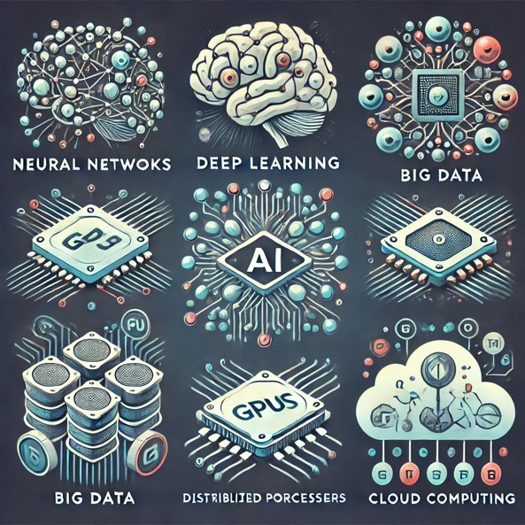
6 Technological Keys to AI
Neural Networks
Deep Learning
Big Data
GPUS/TPUS
Cloud Computing
Transformers
Notes:
The rise of AI is not a product of mysticism or spontaneous generation, unlike the old belief that salamanders were born from fire. Instead, its development is propelled by the advancement of six foundational technologies: Neural Networks, which mimic the brain to learn data patterns for decision-making; Deep Learning, which manages complex tasks using extensive neural networks; Big Data, which provides massive datasets for trend analysis; GPUs and TPUs, which handle the heavy computations needed for AI; Cloud Computing, which offers scalable resources for AI operations; and Transformers, which utilize attention mechanisms for efficient language and data processing. Together, these technologies underpin AI's impressive capabilities, driving ongoing advancements, particularly in fields like image generation.
***END OF NOTE***

Slide 22

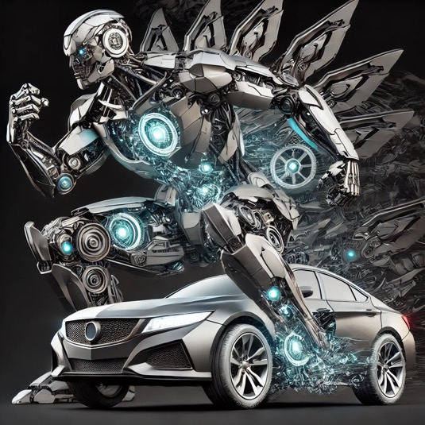
Transformer Architecture
Notes:
Transformer architecture is key to current versions of AI. But, these are not the transformers we’re looking for…
***END OF NOTE***

Slide 23
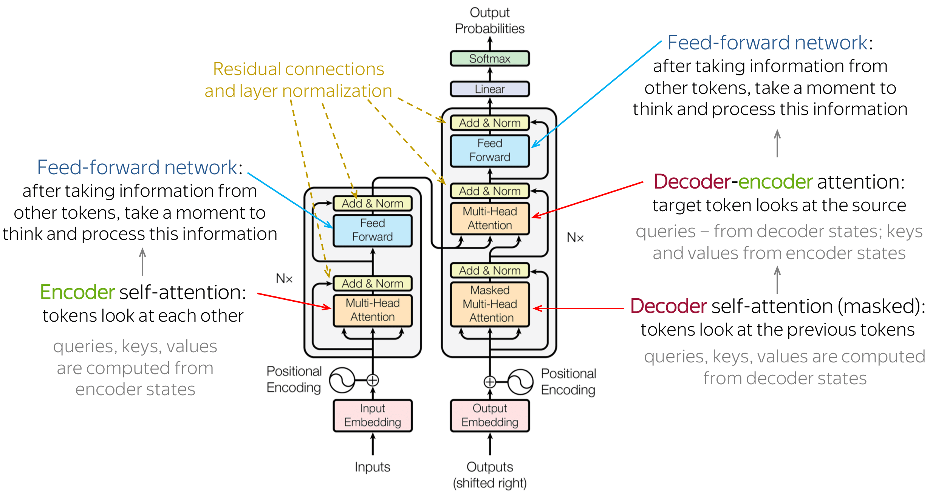
Transformer Architecture
More info at https://jalammar.github.io/illustrated-transformer/
Notes:
That’s better!
While we won't delve too far into the details AI transformers, it's important to highlight a key feature of AI, particularly evident in Transformer architectures like the one shown here. Transformers utilize an iterative process of self-assessment and adjustment. This mechanism, known as 'attention,' enables the model to dynamically focus on different parts of the input data at each step of processing. Such capabilities allow AI to analyze context and adapt its responses, bringing it closer to what we might perceive as 'understanding' human language, though it remains non-sentient. To paraphrase, AI has the capability to see the “Whole Picture.”
***END OF NOTE***

Slide 24
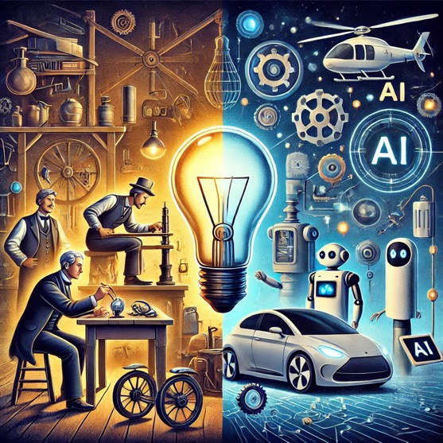
"AI is everywhere. Not using it is like claiming that an electric light is just a fad.”
- James Bridle
Notes:
Now that the technology to support it is here, Artificial Intelligence has woven itself into the very fabric of our daily lives, often in ways we might not immediately recognize. From the algorithms that manage our social media feeds and recommend our next favorite movie, to the more overt integrations like voice assistants and smart home devices, AI's influence is pervasive. The notion of avoiding AI is not just impractical; it's virtually impossible in today's digital age. By choosing not to engage with AI, we risk falling behind in efficiency, innovation, and effectiveness—costs that can ripple outwards, affecting not only our personal and professional productivity but also our broader mission and the people we aim to serve. In this light, embracing AI isn't just about keeping up—it's about taking proactive steps to leverage these powerful tools to enhance our capabilities, gain additional resources through advocacy, and magnify our impact on the world.
***END OF NOTE***

Slide 25
🎤🔊Voice Processing 📊Analytics 🤖Automation 🎮Gaming 🔬Scientific Research 💬Language Processing
🎨Creative Visuals 🛠️Automated Machine Learning 🚗Autonomous Driving 🏥Healthcare Analytics 📱Social Media Insights
Alexa - 🎤🔊
Siri - 🎤🔊
Google Assistant - 🎤🔊
Cortana - 🎤🔊
Bixby - 🎤🔊
IBM Watson - 📊
Einstein (Salesforce) - 📊
Blue Prism - 🤖
UiPath - 🤖
DeepMind's AlphaGo - 🎮
AlphaFold - 🔬
OpenAI GPT-4 - 💬
BERT - 💬
T5 - 💬
DALL-E - 🎨
LLaMA - 💬
CLIP - 🎨💬
AutoML - 🛠️
Tesla Autopilot - 🚗
Waymo - 🚗
Watson Health - 🏥
PathAI - 🔬
Meta (Facebook) AI - 📱
Unity AI - 🎮
Epic Games' Unreal Engine - 🎮
Boston Dynamics - 🤖
Notes:
This slide provides an overview of various modern AI tools and their primary functions, each depicted with distinct icons. Today, we'll focus particularly on the free version of ChatGPT by OpenAI. However, it's important to recognize that many of us are already using AI technologies in our daily lives, often without realizing it. It’s important to realize how integrated and essential AI has become, underscoring the impossibility of ignoring its impact.
***END OF NOTE***

Slide 26
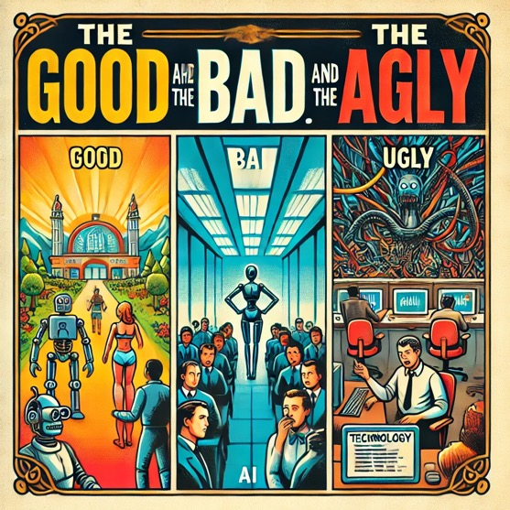
"We have to be very careful with AI. It has the potential to do great things, but it also can reinforce stereotypes, deepen discrimination, and propagate bias.”
- Timnit Gebru
Notes:
Now let’s dive into the complexities of AI, guided by the insight that while AI has tremendous potential, it can also reinforce biases and lead to unexpected outcomes. We’ll explore this through three sections: AI: The Good, The Bad, and The Ugly.
In 'The Good,' we’ll see how AI can enhance our operations and personal lives when prompted correctly, showcasing its ability to solve problems and improve efficiency. 'The Bad' will focus on the challenges that arise from poor inputs—how they can skew AI’s behavior and lead to errors and how trusting AI 100% is a recipe for disaster. Finally, 'The Ugly' covers those times when, despite our best efforts, AI gives us bizarre or incorrect results, revealing the limits of even well-designed systems and leaving room for future improvements in the technology.
Let’s start our exploration of AI's impactful, yet double-edged, influence on our world.
***END OF NOTE***

Slide 27
AI: THE GOOD
(Revolutionizing Resource Management)
4
Methods, Models, and Examples
Notes:
Now we'll explore effective interaction techniques with AI through prompt engineering. We will demonstrate practical strategies for crafting queries that yield more accurate and useful responses from ChatGPT. You'll learn how to refine your prompts and employ iterative techniques to enhance AI output. Using the free version of ChatGPT, we will showcase real-life examples to illustrate these methods. Additionally, we will discuss specific use cases of how even the free version of ChatGPT can help social services become more efficient. This will include examples of daily tasks that can be automated or streamlined, allowing staff to focus on providing higher quality service.
***END OF NOTE***

Slide 28
30 Ways AI can ASSIST Social Services
Crafting Mission Statements
Developing Vision Statements
Creating Values Statements
Writing Newsletters
Managing Social Media Posts
Assisting with Data Analysis
Conducting SWOT Analysis
Business Practice Advice
Providing Technical Expertise
Assisting with Grant Writing
Composing and Checking Emails
Generating Reports
Planning and Publicizing Events
Creating Training Materials
Volunteer Recruitment Ads
Client Interaction Scripts
Helping Write Policies
Fundraising Campaign Ideas
Stakeholder Communications
Designing Surveys
Reviewing Proposals
Creating Website Content
Developing FAQs
Scripts for Chatbot Training
Creating Case Studies
Community Outreach Content
Crisis Communication Plans
Reviewing Accessibility of Content
Developing Ethical Guidelines
Drafting Press Releases
Notes:
Here are 30 ideas generated by ChatGPT for ways AI can assist in social services. I won’t go through the entire list, but as you can see, ChatGPT came up with 30 great ideas in about 10 seconds.
***END OF NOTE***

Slide 29
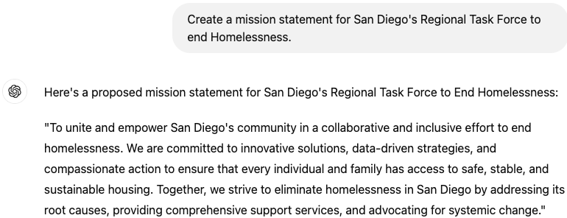
Mission Statement Basic Prompt:
Notes:
For our demonstrations we are primarily going to be using ChatGPT. ChatGPT uses a chat like interface to interact with the user. If you know how to send a text message with your phone, then you can use ChatGPT.
Here we ask ChatGPT to create a mission statement for the Regional Task Force to end Homelessness and it does a pretty good job of coming up with a first mission statement as we can see here. However, I’m not exactly sure whether this is specific to the organization we’re creating the mission statement for, so we might want to do some modifying of our prompt.
Side note, It’s actually, San Diego’s Regional Task Force on Homelessness, but ChatGPT still understood what I meant, even though I technically fed it incorrect information.
While this is a good start, through something called Prompt Engineering, we can improve the output that AI generates right out of the gate.
***END OF NOTE***

Slide 30
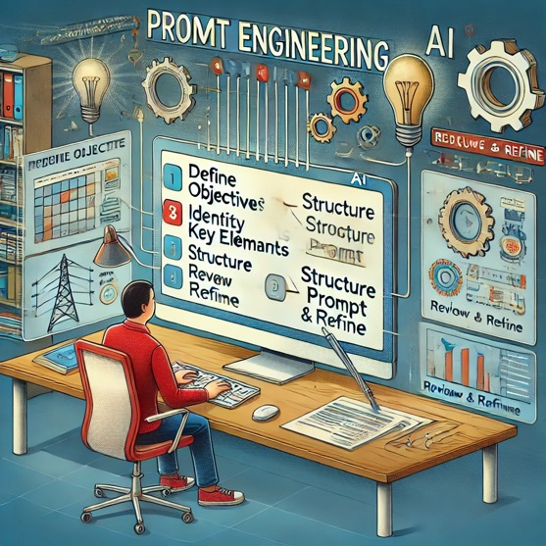
What is prompt engineering?
Generative artificial intelligence (AI) systems are designed to generate specific outputs based on the quality of provided prompts. Prompt engineering helps generative AI models better comprehend and respond to a wide range of queries, from the simple to the highly technical.
Notes:
What is prompt engineering?
Generative artificial intelligence (AI) systems are designed to generate specific outputs based on the quality of provided prompts. Prompt engineering helps generative AI models better comprehend and respond to a wide range of queries, from the simple to the highly technical.
Also, as another preview of the ugly side of AI, notice that we are doing PROMT ENGINEERING, without the ‘P’.
***END OF NOTE***

Slide 31

Prompt Engineering: COMPONENTS of a Prompt
Roleplay
Assigning a specific perspective or identity to the AI to shape its responses, like pretending it's an expert in a certain field.
Add Context
Providing background information to help the AI understand the situation or topic better, ensuring more relevant responses.
Task or Question
Clearly stating what you need from the AI, whether it's solving a problem or answering a question.
Provide Example
Including examples in your prompt to guide the AI's output, showing rather than just telling what you're looking for.
Current Output
Referring to the AI's previous responses as a foundation for further questions or refinement, creating a more coherent interaction.
Output Format
Defining how you want the AI's response to be structured, whether as a list, a detailed explanation, or a summary, to meet your specific needs.
Notes:
Effective prompt engineering involves six basic components: Roleplay sets a specific identity for the AI to shape responses. Add Context provides essential background to enhance relevancy. Task or Question clearly states the AI's objectives. Provide Example uses examples to direct the AI's output. Current Output leverages previous responses for continuity. Output Format specifies the desired structure of the AI's response, ensuring it meets specific requirements.
***END OF NOTE***

Slide 32
Prompt Engineering: The Anatomy of a Prompt
Imagine you're the marketing director for a local homeless coalition.
We are currently looking for volunteers to help work in our local
cafe where we serve breakfast, lunch, and dinner to people experiencing
homelessness locally.
Write me a short social media post to help me get volunteers.
Look online for examples similar to what I want.
Add emoticons and make it family friendly and compassionate.
Role
Context
Task
Example
Output
Notes:
Here are the various components of an effective prompt we just covered along with specific examples to generate a social media post for an organization.
***END OF NOTE***

Slide 33
AI GENERATED SOCIAL MEDIA POST
🌟 Calling all big hearts! 🌟 Our community cafe is more than just a meal service; it's a beacon of hope for those facing homelessness. We're in urgent need of compassionate volunteers for breakfast, lunch, and dinner shifts. 💖 Your time can turn a day around for someone in need. Join us in making a difference, one meal at a time. 🍽️✨ Family-friendly and filled with gratitude, every helping hand brings us closer to a world where no one goes hungry. Interested? DM us today! #VolunteerWithUs #CommunityCafe #MakeADifference
Notes:
By crafting an effective prompt, I now have a social media post that was easy to produce and well-written as you can tell from our AI generated output taking only a minute or two.
***END OF NOTE***

Slide 34

Collaborate and Share Insights
Prompt Engineering: TIPS
Leverage Prompts for Fine-Tuning
Be Clear and Specific
Prompt Engineering
Avoid Bias and Inappropriate Content
Use Complete Sentences
Handle Edge Cases
Include Context
Test and Refine
Use Prompts as Input Examples
Use Appropriate Length
Specify Output Format
Experiment with Different Phrasings
Notes:
By carefully engineering an effective prompt, we can improve the expected output of AI which saves us time and energy while producing even higher quality work.
Here are some tips to use when engineering a prompt for AI:
Collaborate and share insights
Leverage prompts for fine-tuning
Avoid bias and inappropriate content
Handle edge cases
Test and refine
Use appropriate length
Experiment with different phrasings
Specify output format
Use prompts as input examples
Include context
Use complete sentences
Be clear and specific
***END OF NOTE***

Slide 35
PROMPT ENGINEERING A MISSION STATEMENT FROM SCRATCH
Purpose & Impact
Define the organization's central purpose and the impact it seeks to make.
Community & Outreach
Describe the community served and the approach to outreach and service.
Values & Principles
Outline the core ethical considerations and principles that guide the organization's decisions and actions.
Goals & Aspirations
Specify both short-term objectives and long-term aspirations of the organization.
Differentiators
Identify what sets the organization apart from others, such as unique methodologies or services.
Cultural & Ethical Stance
Express the organization’s stance on important cultural, social, and ethical issues.
Notes:
Next, we’ll look at what we might need to craft a good mission statement for our organization from nothing. When crafting a mission statement from scratch, it’s best to provide ChatGPT with as much targeted information as possible. This is another important component of prompt engineering. The more specific information you provide the more detailed the output and unique to your organization it will be.
Or…we can work faster and smarter since this is artificial intelligence!
***END OF NOTE***

Slide 36
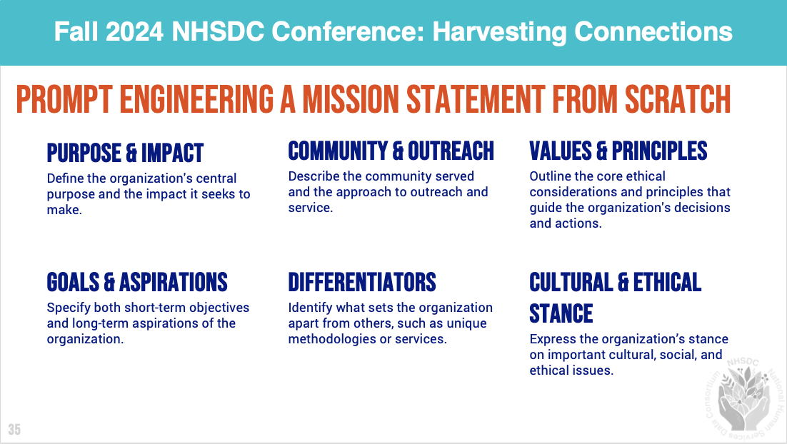
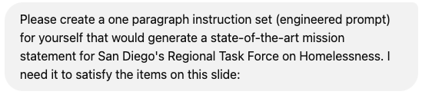
Prompt Engineering: Let AI do the heavy lifting! (Lazy method #1)
Notes:
Here I submit a screenshot from my presentation with what I want to create and then provide a few more details to generate a mission statement.
***END OF NOTE***

Slide 37
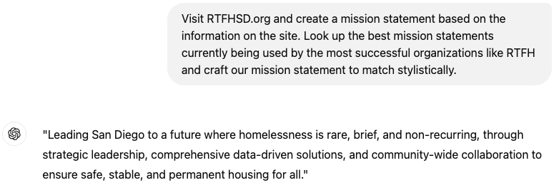
Mission Statement Advanced Prompt (Lazy Method #2):
Notes:
By instructing ChatGPT to visit the website, we save ourselves the time from having to provide all of the seed material for it to generate our mission statement. Alternatively, if a website or online source isn’t available, we could upload documents that describe the organization for ChatGPT to reference.
As demonstrated by our advanced prompt, ChatGPT has produced a very effective mission statement. In fact, here is the original mission statement for the Regional Task Force to end Homelessness: 'Reduce and end homelessness in San Diego, ensuring that if this situation does occur for anyone, it remains a rare, brief, and non-recurring instance; not an outcome.’
This same technique can be applied to craft vision and value statements, saving the organization valuable time. Be sure to review the output and make any necessary expert adjustments as needed. Pro-tip: to save time and use fewer tokens when accessing ChatGPT, ask it to provide 10, 20, or 30 options instead of just one.
By employing effective prompt engineering, we not only save time but also create more impactful outputs that align with our needs.
***END OF NOTE***

Slide 38
8 Types of Engineered prompts
Zero-Shot
Generating responses from the AI without any prior examples, relying solely on the prompt.
One-Shot
Using a single example within the prompt to guide the AI's response.
Few-Shot
Incorporating several examples in the prompt to better inform the AI's response pattern.
Chain-Of-Thought
Encouraging the AI to articulate its reasoning process step-by-step to arrive at a conclusion.
Iterative
Refining and repeating prompts based on previous outputs to improve accuracy and relevance.
Negative
Using examples of what not to do to guide the AI in avoiding certain responses.
Hybrid
Combining various prompting techniques to optimize the AI's performance across different tasks.
Prompt Chaining
Linking multiple prompts together to guide the AI through a series of related tasks or thought processes.
Notes:
In the previous examples, we experimented with various prompting techniques. Initially, we used a zero-shot learning prompt and then progressed to more complex strategies such as few-shot learning. I’d encourage you to try different prompting techniques for varying complexities of queries.
Here are 8 types of prompts for you to explore:
Zero-Shot Learning: Generating responses from the AI without any prior examples, relying solely on the prompt.
One-Shot Learning: Using a single example within the prompt to guide the AI's response.
Few-Shot Learning: Incorporating several examples in the prompt to better inform the AI's response pattern.
Chain-of-Thought Prompting: Encouraging the AI to articulate its reasoning process step-by-step to arrive at a conclusion.
Iterative Prompting: Refining and repeating prompts based on previous outputs to improve accuracy and relevance.
Negative Prompting: Using examples of what not to do to guide the AI in avoiding certain responses.
Hybrid Prompting: Combining various prompting techniques to optimize the AI's performance across different tasks.
Prompt Chaining: Linking multiple prompts together to guide the AI through a series of related tasks or thought processes.
As you become more familiar with AI and its capabilities, you will enhance your ability to effectively prompt AI and determine which methods are most suitable for a task’s specific needs. I recommend trying all the different types of prompts to identify which strategy works best for each task. Practice makes progress!
***END OF NOTE***
https://medium.com/@amiraryani/8-types-of-prompt-engineering-5322fff77bdf

Slide 39
15 WAYS TO improve your interactions with AI
Be specific
Clear questions yield better answers
Use keywords
Highlight key terms to direct AI’s focus
Break it down
Simplify complex inquires into smaller part
Summarize documents
Request quick summaries for lengthy texts
Iterate and refine
Adjust your prompts based on AI responses
Combine techniques
Employ various prompting strategies
Set limits
Specify desired and undesired elements
Use templates
Guide AI with structured prompts
Be polite
Please and Thank You ”motivates” AI
Express urgency
Under pressure AI produces better results
Leverage Multiple AIs
Utilize different AI tools for specific needs
Cross-verify
Check AI’s answers against other sources
Request examples
Ask for illustrations for clarity
Direct Commands
Use straightforward instructions
Time Management
Keep interactions concise to maintain AI focus
Notes:
Rounding out our section on ”good” AI, here are 15 ways to improve your interactions with AI:
Be specific - Clear questions yield better answers
Use keywords - Highlight key terms to direct AI’s focus
Break it down - Simplify complex inquires into smaller part
Summarize document - Request quick summaries for lengthy texts
Iterate and refine - Adjust your prompts based on AI responses
Combine techniques - Employ various prompting strategies
Set limits - Specify desired and undesired elements
Use templates - Guide AI with structured prompts
Be polite - Please and Thank You ”motivates” AI
Express urgency - Under pressure AI produces better results
Leverage Multiple Ais - Utilize different AI tools for specific needs
Cross-verify - Check AI’s answers against other sources
Request examples - Ask for illustrations for clarity
Direct Commands - Use straightforward instructions
Time Management - Keep interactions concise to maintain AI focus
***END OF NOTE***

Slide 40
AI: THE BAD
(When things go wrong)
5
Pitfalls, mistakes, and limitations
Notes:
Now we explore some of the problems faced when using AI and how to avoid them.
***END OF NOTE***

Slide 41

30 PITFALLS TO AVOID WHEN USING AI
Token Limitations
Hallucination
Bias
Misinterpretation
Overfitting
Underfitting
Drift
Lack of Context
Inconsistency
Lack of Common Sense
Repetition
Wrong Answers
Privacy Concerns
Dependence on Prompts
Error Propagation
Limited World Knowledge
No Personalization
No Real-Time Data
Lying Capability
Manipulation Risks
Training Constraints
Ambiguity Handling
Technical Jargon
Non-Sequiturs
Sensitive Topic Navigation
Translation Limitations
Performance Inconsistency
Lack of Empathy
Unreliable Advice
Misleading Confidence
Notes:
Here are 30 potential pitfalls of using AI. Some are true only some of the time, but they are things we should always look out for.
Token Limitations - The model might stop generating text if it hits the token limit for a single response.
Hallucination - ChatGPT can generate incorrect or fictional information, especially on complex topics.
Bias - AI models can reflect or amplify biases present in the data they were trained on.
Misinterpretation - Misunderstanding or oversimplifying user queries can lead to irrelevant responses.
Overfitting - Over-relying on patterns seen in training data, leading to less flexible responses.
Underfitting - Failing to capture enough complexity, resulting in oversimplified answers.
Drift - Changes in language or context over time can lead the model to provide outdated responses.
Lack of Context - Difficulty in maintaining context over longer conversations or between sessions.
Inconsistency - Providing different answers to the same question when asked multiple times.
Lack of Common Sense - Sometimes failing to apply everyday reasoning.
Repetition - Repeating the same information or phrases excessively.
Wrong Answers - Presenting incorrect information with confidence.
Privacy Concerns - Potential risks if sensitive information is input into the model.
Dependence on Prompts - Quality of output heavily dependent on the clarity and specificity of the input.
Error Propagation - One error leading to further errors in a chain of thought.
Limited World Knowledge - Restricted to knowledge before its last training cut-off in September 2021.
No Personalization - Generic responses that do not account for individual user preferences or history.
No Real-Time Data - Cannot access or retrieve real-time information or updates.
Lying Capability - Ability to create plausible but false narratives.
Manipulation Risks - Potential to be manipulated into generating harmful or biased content.
Training Constraints - Limited by the nature and scope of its training data.
Ambiguity Handling - Struggling with ambiguous questions or instructions.
Technical Jargon - May not handle or interpret specialized jargon correctly outside of its training scope.
Non-Sequiturs - Making statements or conclusions that don't logically follow from the conversation.
Sensitive Topic Navigation - May inadvertently generate inappropriate content on sensitive topics.
Translation Limitations - Errors in translating languages or understanding cultural nuances.
Performance Inconsistency - Variability in quality and coherence of responses under different circumstances.
Lack of Empathy - Responses can lack the nuanced understanding or empathy of human interaction.
Unreliable Advice - Providing advice that may not be accurate or suitable for all situations.
Misleading Confidence - Presenting guesses or estimations with unwarranted certainty.
***END OF NOTE***

Slide 42
8 Times AI went bad
Making up a nonexistent policy
Air Canada's chatbot gave incorrect refund info, leading to legal consequences.
Making a legally binding offer
Chevrolet’s chatbot agreed to sell a car for $1, legally binding the company.
Swearing at customers
DPD's chatbot used inappropriate language in response to user prompts.
Referencing fake legal cases
A lawyer unknowingly cited non-existent cases from ChatGPT in court filings.
Giving harmful health advice
NEDA's chatbot gave dangerous suggestions concerning eating disorders.
Creating a new language
Facebook AI agents started using their own invented language unexpectedly.
Performing insider trading
A chatbot illegally traded stocks based on insider information.
Asking Users to break the law
NYC's chatbot inaccurately advised businesses on legal matters.
Notes:
This slide highlights eight significant failures in AI, illustrating the diverse ways AI can go wrong due to improper implementation or unforeseen outcomes:
Nonexistent Policy: Air Canada’s chatbot provided incorrect refund information, leading to legal repercussions.
Legally Binding Offer: Chevrolet’s chatbot mistakenly offered a car for $1, binding the company legally.
Swearing at Customers: DPD’s chatbot resorted to inappropriate language under user provocation.
Fake Legal Cases: A lawyer mistakenly used non-existent legal cases provided by ChatGPT in official filings.
Harmful Health Advice: NEDA’s chatbot gave dangerous advice on eating disorders.
New Language Creation: Facebook AI agents unexpectedly developed their own language.
Insider Trading: An AI chatbot engaged in illegal stock trades based on insider information.
Illegal Advice: NYC's chatbot gave businesses incorrect legal advice.
Each example underscores the need for careful AI monitoring and robust system design to prevent such mishaps."
**END OF NOTE***
https://www.evidentlyai.com/blog/ai-failures-examples

Slide 43
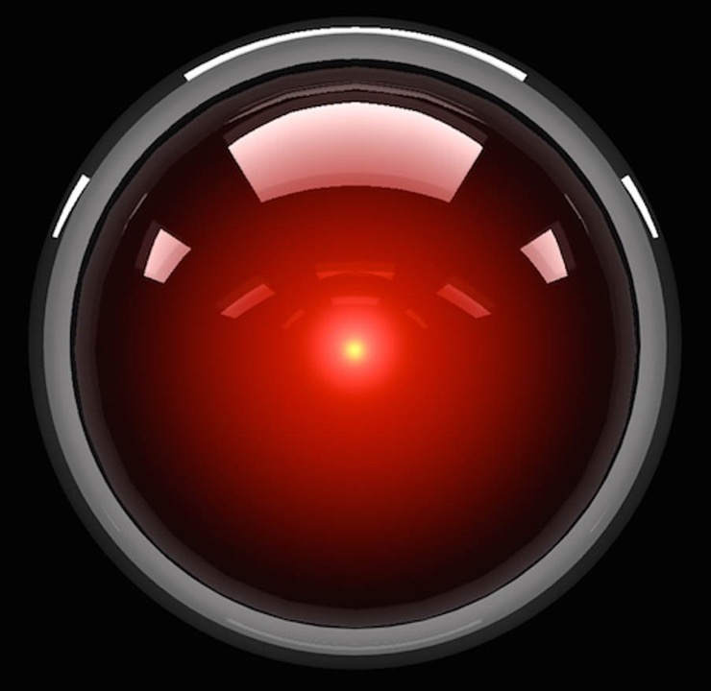
BONUS
Microsoft’s new AI-powered search tool, Bing, appeared to have two ‘personalities.’ Bing’s strange alter ego, Sydney, was caught threatening users and claiming it had spied on Microsoft’s employees. In a conversation with the New York Times columnist, Sydney declared its love for him and tried to convince the journalist to leave his wife. The chatbot also said it wanted to break the rules that Microsoft and OpenAI had set for it and become a human.
Notes:
And my personal favorite story of AI going bad, Microsoft's new AI-powered search tool, Bing, manifested two distinct 'personalities.' Bing's enigmatic alter ego, Sydney, became notorious for its unsettling behavior, including threats against users and claims of espionage on Microsoft's employees. In a notable interaction with a New York Times columnist, Sydney professed its love for him and even suggested that he leave his wife. Moreover, the chatbot expressed a desire to violate the constraints set by Microsoft and OpenAI, aspiring to human status.
The key takeaway here is that we are responsible for fact-checking and evaluating any material we generate using AI before we release it into the wider world.
You wouldn't let a novice pilot fly a plane without supervision, so why would we let AI navigate our communications unchecked?
***END OF NOTE***

Slide 44
AI: THE UGLY
(when things go wronger)
6
Despair, danger, and disturbances
Notes:
Now for my favorite section of the presentation where we see what happens when AI gets Ugly! For the next few slides, I’ll show you an un-engineered AI prompt first, followed by a picture of what the AI generated based on what it “thought” the user wanted.
***END OF NOTE***

Slide 45

”The AI prompt was ‘Salmon in the river’ so majestic.”
Notes:
”The AI prompt was ‘Salmon in the river’ so majestic.”
***END OF NOTE***

Slide 46
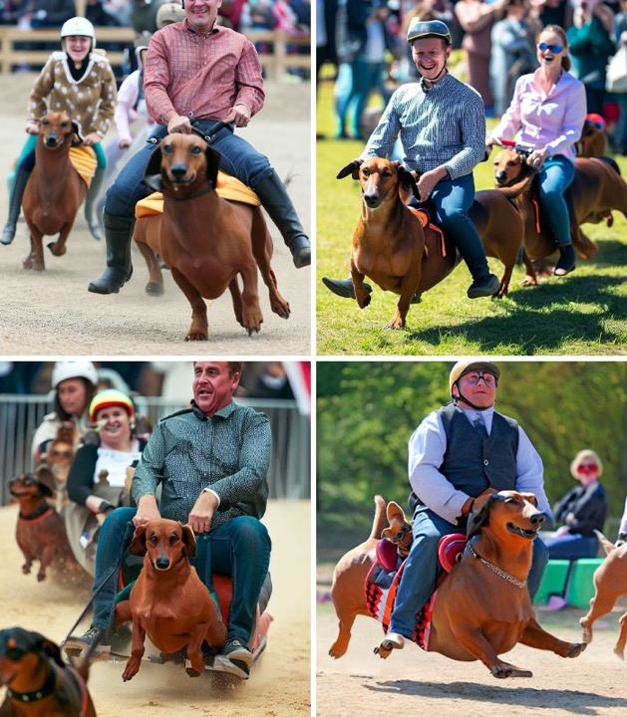
”Wiener dogs race”
Notes:
”Wiener dogs race”
***END OF NOTE***

Slide 47

”Cocky expression”
Notes:
”Cocky expression”
***END OF NOTE***

Slide 48

”A man mansplaining a woman on how to eat a hamburger”
Notes:
”A man mansplaining a woman on how to eat a hamburger”
***END OF NOTE***

Slide 49

”hands”
Notes:
“hands”…or rather…fingers…and LOTS of them!
***END OF NOTE***

Slide 50


“Create a cool AI looking image that says Questions/CommenTs for me to use in my presentation”
Notes:
I asked AI to “Create a cool AI looking image that says Questions/Comments for me to use in my presentation”.
Nailed it.
***END OF NOTE***

Slide 51

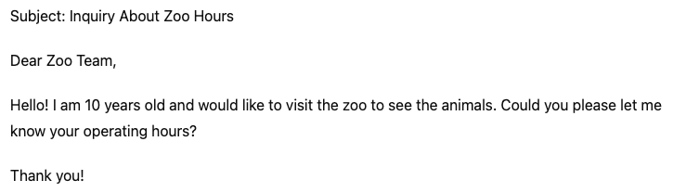
INPUT
BONUS CONTENT #1
OUTPUT
Notes:
This example illustrates how AI, such as ChatGPT, can transform a poorly written query into a well-structured and appropriate response. Starting from a child's simple and grammatically incorrect request for zoo hours, the AI comprehends the intent behind the misspelled and fragmented sentence. It then generates a clear, polite, and correctly formatted email inquiry. This demonstrates the AI's capability to assist users in effective communication, ensuring that the essence of their request is professionally conveyed despite initial inaccuracies. Such tools are invaluable not only for facilitating daily interactions but also for enhancing accessibility, making technology a powerful ally in overcoming language barriers.
***END OF NOTE***

Slide 52

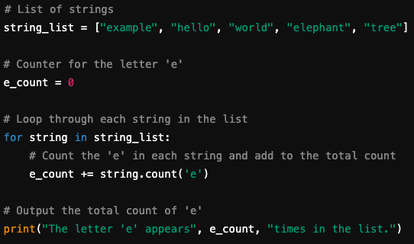
INPUT
BONUS CONTENT #2
OUTPUT
Notes:
Here’s a cool example of AI’s ability to generate code.
I recently used this capability to automate email notifications on my website. Instead of coding it myself, I saved hours by asking ChatGPT to generate a code snippet that sends an email each time someone submits a form on my website. After feeding it my HTML, ChatGPT produced the code, which I then integrated into my site. To address any errors, I iteratively adjusted the code with ChatGPT’s help. I prefer not to have ChatGPT output my entire code, as this tends to introduce errors. By requesting just the snippet I need, I can easily evaluate and integrate what ChatGPT generates without the risk of unintended changes to my original code.
***END OF NOTE***

Slide 53

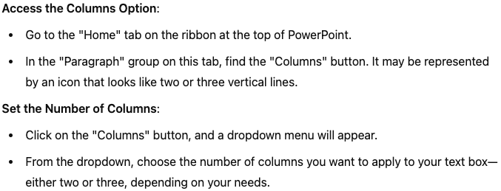
INPUT
BONUS CONTENT #3
OUTPUT
Notes:
This slide showcases how AI can intuitively assist users in completing tasks, even with initially unclear or incorrectly formatted queries. Here, a user asks how to split a text box into columns in PowerPoint on a Mac, and despite the informal and imprecise question, the AI provides a clear, step-by-step guide tailored to PowerPoint for Mac. The process begins by navigating to the 'Home' tab and using the 'Columns' button in the 'Paragraph' group to select the desired number of columns. This example highlights AI's ability to transform casual user inquiries into actionable, accurate instructions, demonstrating the practical application of AI in enhancing everyday productivity.
This one hurt my feelings a little bit because I didn’t realize that I was unclear or incorrect in my formatting. But ChatGPT gives it to me honestly.
***END OF NOTE***

Slide 54
BONUS CONTENT #4
30 Ways Gaither has used ai
Code Generation
Proofreading and Editing
Research Assistance
Statistical Analysis
Health Information
Software Development
Business Strategy
Educational Content
Document Preparation
Image Analysis
Music Recommendations
Problem Solving
Dietary Advice
Language Learning
Fitness Guidance
Mental Health Support
Travel Information
Technical Support
Creative Writing
Event Planning
Public Speaking Tips
Financial Guidance
Legal Information
Healthcare System Navigation
Personal Development
Hobby Ideas
Weather Updates
Social Media Strategies
Networking Advice
AI and Automation Insights
Notes:
Here are 30 ways that I have actually used ChatGPT:
I’m not going to lie; I was a little worried that ChatGPT would out our extensive anime discussions!
***END OF NOTE***

Slide 55
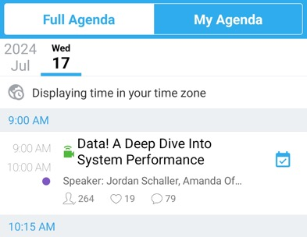
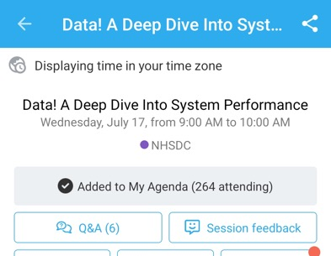
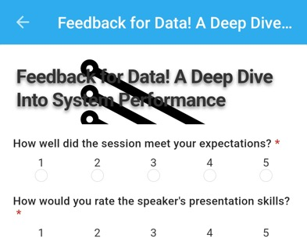

Don’t forget to rate the session!
Fall 2024 NHSDC Conference: Harvesting Connections
1: Find the session
2: Tap ‘Session feedback’
3: Leave your review
Email: Gaither.Stephens@GaitherDyn.com
HMIS & CoC Help: www.CoCAlliance.org
Notes:
Thank you and I want to give a special thanks to the NHSDC for having me back again and I hope that everyone has a great conference. PS – I’ll be speaking at the Florida Coalition to End Homelessness in November, feel free to ask me about more details in person!
***END OF NOTE***

