Slide 1
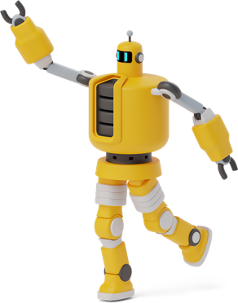
AI in Social Services: Enhancing Organizational Efficiency
GAITHER STEPHENS
Notes:
Set up camera, get water, use the restroom. Start music for audience.
***END OF NOTE***

Slide 2
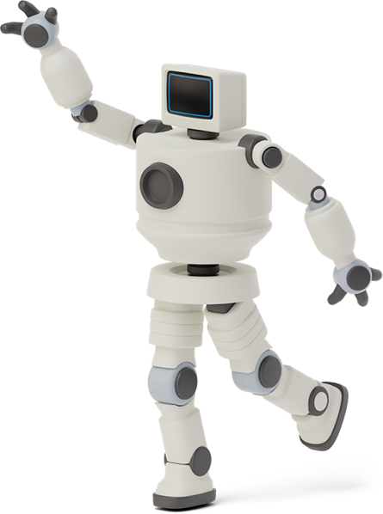
Hello!
GAITHER DYNAMIC
CEO
CHARLOTTE COUNTY HOMELESS COALITION
Board Member
COC ALLIANCE
Founder
I am Gaither Stephens
You can find me at Gaither.Stephens@GaitherDyn.com
Notes:
Thank you all for joining me today, and a special thanks to the NHSDC for inviting me back! The NHSDC is a pillar of positive change, and I can honestly say I wouldn’t be where I am without it.
I understand we all have tasks looming in the background, so if you need to attend to other work while you're here, please go right ahead. Time is a valuable resource, and I respect that. Lastly, questions are always welcome, so don't hesitate to chime in at any point during the presentation. Let's make this an interactive and enlightening session for all!
While I have you all here, I’d like to take the time to formally invite you to the CoC Alliance if you’re not already a member. It’s a simple Slack group with over 1300 members that help each other in the areas of CoC work and HMIS. To join the Slack group, simply visit www.CoCAlliance.org.
***END OF NOTE***

Slide 3
AGENDA
The AI Advocate AI’s Practical Impact on Social Missions
The Early Build
Gaither’s Journey from Code to Compassion
The AI Journey
From Turing to Today
The End Questions/Thank You/Contact
1
3
5
7
0
2
4
6
WELCOME
(YOU ARE HERE)
Stretched to the Limit
The Strain on Social Services
The AI Assistant Revolutionizing Resource Management
AI Mastery Essential Strategies for Success
Notes:
Today, we'll traverse through my story, from broadcasting on the radio to impacting lives, drawing strategies from my own experiences. We'll then navigate the complex landscape of social services, tackling challenges and envisioning solutions. Our adventure will take us into the world of AI and the wonders of AI chatbots, where I'll share not just knowledge but practical, hands-on examples.
By the end of this session, armed with tips and real-world applications, you'll be ready to leverage AI's prowess to its fullest. And if time smiles upon us, we'll dive into a live demonstration that showcases the agility of AI in action.
So, let's embark on this transformative path, unlocking potentials and pioneering change, together.
***END OF NOTE***

Slide 4
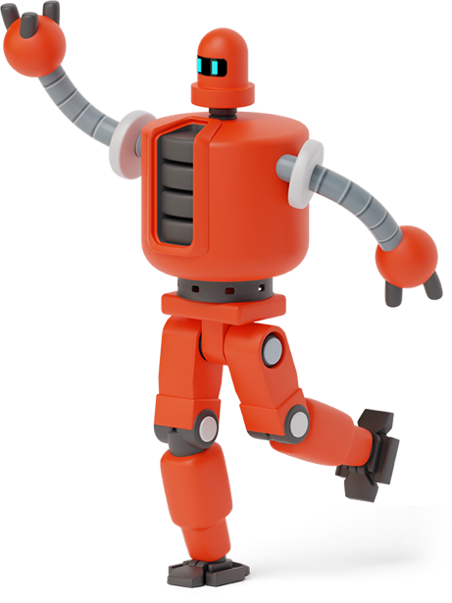
The Early Build: Gaither’s Journey from Code to Compassion
1
Background, Education, & Experience
Notes:
I’m going to take a few moments during this next section to introduce myself, tell you a little bit about my journey through life, and how that journey lead me here!
***END OF NOTE***

Slide 5
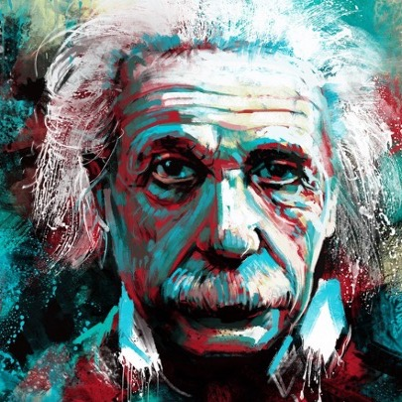
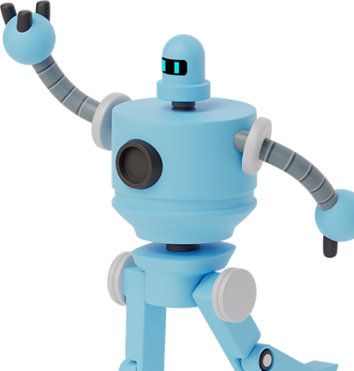
“Once we accept our limits, we go beyond them.”
-Albert Einstein
Notes:
Albert Einstein once said, Once we accept our limits, we go beyond them. Understanding our limitations doesn't mean we're settling for them or using them as excuses. Rather, it provides a clear starting point for growth. By acknowledging what holds us back, we can devise specific strategies to go beyond those barriers. Limits are not the end; they are merely waypoints on the journey to improvement. Many suspect that Einstein may have had high functioning autism, yet he still accomplished great things! We’ll revisit this in a moment.
On a side note, I could not use a popular AI chatbot to generate a picture of Einstein because he is a real person.
***END OF NOTE***
Pic source: https://quotesgram.com/img/albert-einstein-quotes-wallpaper/9636239/

Slide 6
Know thyself and thy difficulties: Autism & ADHD
Autism
Difficulty with social interactions
Sensory processing issues
Difficulty with verbal and non-verbal communication
Rigid routines and resistance to change
Repetitive behaviors or interests
ADHD
Difficulty maintaining attention
Impulsive behavior
Hyperactivity and restlessness
Disorganization and time management problems
Challenges in following instructions and completing tasks
Notes:
Sorry if this slide catches anyone off guard! Revealing that I possess traits associated with ADHD and ASD isn't a simple footnote in my biography; it's pivotal for grasping the lens through which I navigate both personal and professional landscapes. Icons like livestock system innovator Temple Grandin and acclaimed actor Sir Anthony Hopkins share similar neurodiverse profiles, exemplifying how unique cognitive structures can drive exceptional accomplishments.
Only recently diagnosed, I've reframed these traits as the backbone supporting my specialized abilities. To operate at what society calls a 'baseline,' I’ve hyper-focused on organization, vigilance, and systematization—skills that ultimately propel me to exceed typical performance levels. And I’ve pursued tools to support me and succeed in both my work and my personal life.
This drive has birthed intricate support systems and algorithms that minimize error while maximizing output. When I say that ADHD and ASD form part of my identity, recognize this not as a limitation but as an engine for innovation and efficiency, particularly in settings where resources are scarce.
***END OF NOTE***

Slide 7
Education
Associate of Science DEGREE
Computer Science & Information Systems
Dean’s List (multiple semesters)
3.28 GPA
Bachelor of Science DEGREE
Business Administration
Magna Cum Laude
3.83 GPA
Master of Science DEGREE
Computer Information Systems
Concentrations in Database Management & Business Intelligence
3.57 GPA
Notes:
As you can see, even though I face challenges due to my autism and ADHD, I can still perform at high levels and succeed. I’m able to succeed because I’ve built connections to help me, I study every subject to its minute levels, and build tools to support me. When I first started college as a working adult, I had to start all over teaching myself how to do homework, sustain projects, build applications, and generally just make sure I showed up to class! Now, I love to learn and look forward to completing my PhD some day!
***END OF NOTE***

Slide 8
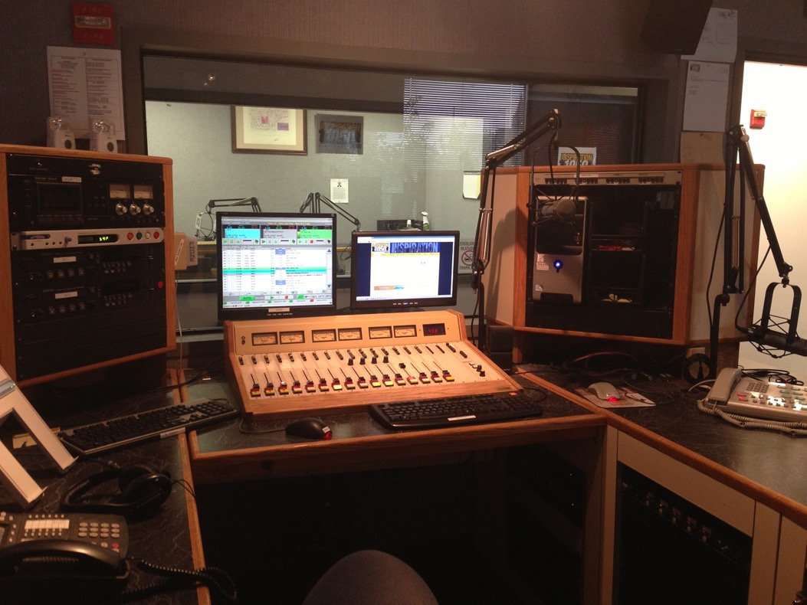
INSPIRATION 1050 WGRI Studios Cincinnati, Ohio
Notes:
In fact, even though I graduated high school with a GPA around 1.56, I was still able to succeed in radio for almost two decades earning over $1million despite my disabilities. Also, I’d like to point out that just because someone has a disability or even multiple disabilities, that does not automatically make them disabled. Although I had many challenges that I faced personally, educationally, and professionally, I found that by building supports and using tools, I could not only reach nominal performance levels, but even exceed them! For many years I successfully managed 5 radio stations with 3 offices and 10 studios spread across 2 states, all never even knowing I had disabilities.

Slide 9
Stretched to the limit: The strain on social services
2
Adversity, Advocacy, & Advancement
Notes:
Next, we’re going to address large challenges currently faced in social services, their root causes, and potential solutions.

Slide 10
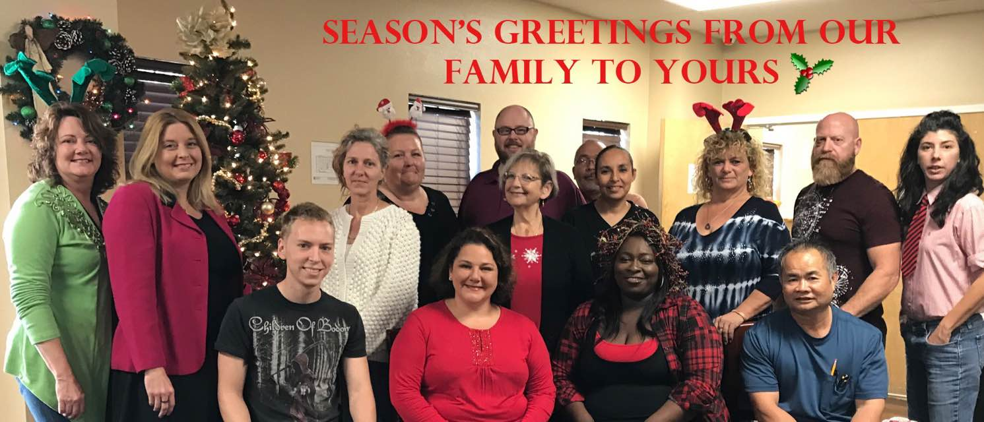
2016 Staff Christmas photo Charlotte County Homeless Coalition
ME
Notes:
In 2016 I was hired as a data analyst for the Charlotte County Homeless Coalition, and I had no idea what I was getting myself into! On a side note, only one person in this picture still works for the organization due to high turnover.

Slide 11
Challenges faced in social services
🎈
Multiple Hats
CTO, Marketing Director, IT, Training, Support, PIT, HIC, SysPM, LSA, Veteran & Chronic Committee Meetings Leader, etc.
Outdated System
Exchange 2007 server that only allowed email use within the physical building and the server hard drive was constantly getting full.
Security Issues
Every user in system had Sys Admin II highest level security access, including an account shared by 18 volunteers at a local church.
Incorrect Setup
Every project was set up as the top project meaning there was no hierarchy in our system, just a large forest with individual trees.
Data Quality
The system had false data, poor data, and missing data. Data quality was an ‘F’ across the board making reports completely unreliable.
Lost Revenue
Previous data analyst missed NOFA deadline and lost $200,000 in HUD funding for the Continuum of Care.
Notes:
In this section of my talk, I'm going to give you a quick overview of the challenges we've faced in social services due to a lack of resources and efficiency:
Multiple Hats: In my role, I had to wear many hats—from CTO to Marketing Director, IT to Training and Support, and even lead various committee meetings.
Outdated System: We grappled with an obsolete Exchange 2007 server that limited email access and was perpetually full.
Security Issues: A critical vulnerability we faced was that every system user, including volunteers, had the highest level of security access.
Incorrect Setup: Our projects lacked a clear hierarchy, akin to a forest of individual trees with no discernible order.
Data Quality: The integrity of our data was compromised, plagued by inaccuracies and missing information, rendering reports unreliable.
Lost Funding: A substantial challenge was the loss of $200,000 in HUD funding due to a missed deadline by a previous analyst.
Each of these points highlights the critical need for better resource management and efficiency in social services.
***END OF NOTE***

Slide 12
The Persistent Problem of Homelessness in the United States
As of 2020, there were ~350 organizations competing for an insufficient amount of federal dollars to end homelessness for over 580,000 people across the United States.
*Picture generated with AI
Notes:
As we turn our attention to this slide, it's crucial to acknowledge the ongoing challenge of homelessness. Despite the efforts of roughly 350 organizations across the nation, the reality is that as of 2020, the federal funds available were simply not enough to support over 580,000 Americans in need of housing. This underscores a persistent gap between our aspirations and the resources allocated and it’s only getting worse.
***END OF NOTE***

Slide 13
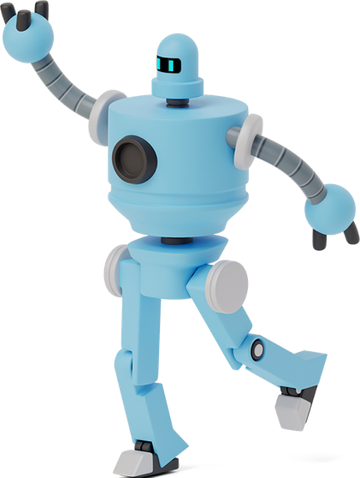
~$20 billion
~$4 billion
~$16 billion
Cost to end homelessness
Amount dedicated in 2023
Annual deficit
Notes:
Back in 2012, Mark Johnston, then with HUD, gave a quick guess at the number to end homelessness and he came up with $20 billion. It’s widely accepted that this number is very much on the low side.
In 2023 congress put aside $3.633 billion towards homelessness.
Even with a conservative estimate, we are easily seeing over a $16 billion deficit each year in spending. How could we ever make up this deficit? Do we even have this kind of money as a country? Let’s find out!
https://www.verifythis.com/article/news/verify/social-justice/20-billion-not-enough-eradicate-homelessness/536-87f9cba3-5654-4f5b-845c-2f57716c8850
https://endhomelessness.org/blog/the-presidents-budget-and-homelessness-impacts-for-the-coming-year/
***END OF NOTE***

Slide 14
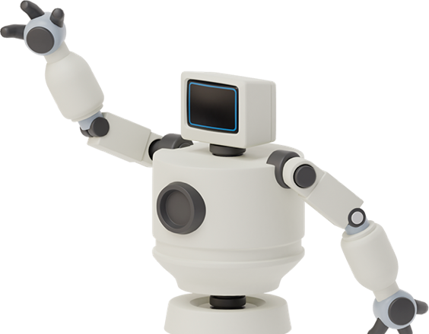
$773 Billion
💣
United States Fiscal Year 2023 Military Budget
Notes:
On the governmental front, there is a military budget of $773 billion, which encompasses spending on projects such as the F-35 program, notoriously costing $1.5 trillion. Redirecting funds from this budget may be feasible, albeit potentially controversial. Are there alternative sources of funding that could be tapped into?
***END OF NOTE***

Slide 15
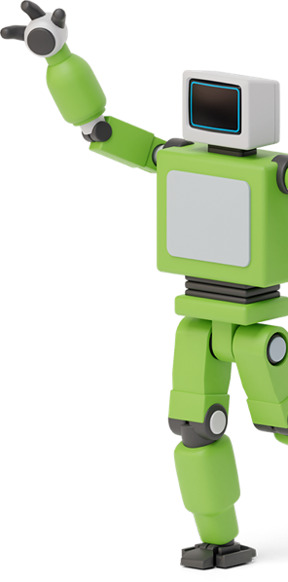
What we spend money on instead of homelessness
Video Games
Streaming Services
Cosmetics
Fashion Retail
Candy & Chocolate
Soft Drinks
Alcohol Beverages
Coffee Shops
Gym Memberships
Pet Products
Luxury Goods
Mobile Apps
E-sports
Cruises
Them Parks
Movie Theaters
Jewelry
Toys & Games
Sports Betting
Art Market
Subscription Boxes
Sneakers & Shoes
Bottles Water
Vaping & E-cigarettes
Fantasy Sports
Gourmet & Specialty Foods
Board Games & Puzzles
Craft Beer
Wedding Industry
Outdoor Equipment
Notes:
In considering the financial commitment to addressing homelessness in the United States, it's illuminating to compare the expenditure in this area to the revenues from industries that are largely discretionary. The threshold for this comparison is set at $4 billion, which is notably surpassed by each of the following industries:
Video Games: The industry’s revenue is 15 times greater than the $4 billion threshold.
Streaming Services (Music & Video): Their revenue is 8 times the benchmark.
Cosmetics: This market's valuation is over 12 times the baseline amount.
Fashion Retail: Fast fashion alone generates 9 times the threshold.
Confectionery (Candy & Chocolate): Expenditures are 9 times more than the baseline.
Continuing this trend, even further down the list:
Alcoholic Beverages: The revenue is a staggering 63 times greater than the threshold.
Coffee Shops: Over 11 times the baseline spending on homelessness.
Pet Products and Services: More than 25 times the threshold.
Luxury Goods: Exceed the benchmark by more than 21 times.
These comparisons strikingly highlight that the allocation of funds is a matter of priority. The revenue from just one of these industries could significantly transform the landscape of resources dedicated to homelessness in the U.S. It’s clear that as a society, the resources exist—the challenge lies in choosing to redirect even a fraction of these funds to address critical social issues.
***END OF NOTE***

Slide 16
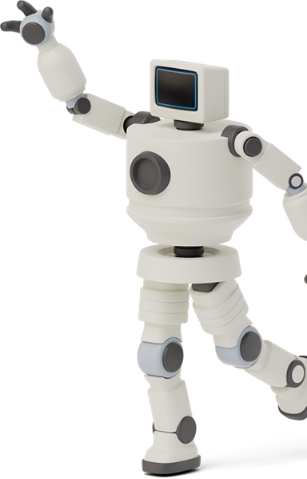
Consequences of resource scarcity
🎈
Unequal Service Allocation
Scarce resources often lead to inequitable distribution of services, hitting vulnerable populations the hardest.
Compromised Care Quality
When resources are scarce, the quality of care deteriorates, making social interventions less effective.
Flawed Data
Limited funding impacts accurate data collection, leading to unreliable insights and misguided policy decisions.
Staff Burnout
Overburdened staff with limited resources often suffer from burnout, resulting in decreased productivity and higher turnover.
Operational Waste
Inadequate monitoring tools can lead to inefficient resource use, exacerbating existing scarcities.
Stifled Strategic Planning
Immediate concerns take precedence when resources are limited, hampering long-term planning and adaptability.
Notes:
In our efforts to allocate funds across various sectors in our nation, we inadvertently impose restrictions on our capacity to assist those in need, which signals a troubling misalignment of our societal priorities. This is precisely where advocacy plays a crucial role in our profession. The current lack of emphasis on homelessness and social services in the United States leads to a series of significant challenges:
Unequal Service Allocation: Limited resources often result in unequal distribution of services, disproportionately impacting the most vulnerable populations.
Compromised Care Quality: When resources are stretched, the quality and effectiveness of social services can diminish.
Flawed Data: Insufficient funding can lead to inadequate data collection, yielding unreliable insights that could misinform policy decisions.
Staff Burnout: Resource scarcity can lead to burnout among workers, reducing productivity and leading to higher turnover rates.
Operational Waste: Without the right monitoring tools, resource usage can become inefficient, exacerbating the issues of scarcity.
Stifled Strategic Planning: With a focus on immediate concerns due to limited resources, long-term strategic planning and the flexibility of organizations can suffer.
As we move forward, it's critical to view these issues not as unmanageable obstacles but as areas where the strategic application of technology and innovation can drive meaningful change.
***END OF NOTE***

Slide 17
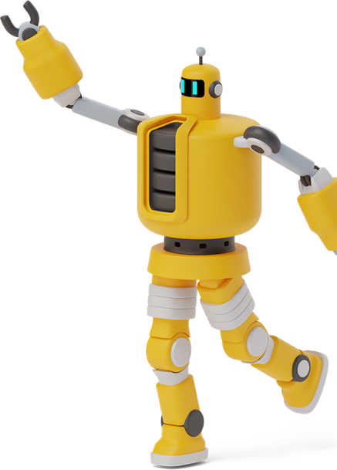
Two-pronged strategic planning
Maximizing Efficiency
In a landscape where resources are scarce, it is incumbent upon us to be exceptional stewards of what we possess. Our mandate is to optimize and extend our resources, ensuring they reach their fullest potential in alignment with our objectives.
Championing Adequate Resources
Sustainable growth is unattainable in the shadow of continuous scarcity. It becomes essential, then, to champion the cause for increased resources. This often requires the strategic allocation of those same scarce resources to ensure our voice for change is heard and heeded.
Notes:
When addressing the issue of resource scarcity in tackling social problems, we come to understand two fundamental truths:
Firstly, the resources currently at our disposal are inadequate for solving our problem. The key here is maximizing efficiency. It is our responsibility to manage what we have with the utmost care, making sure every asset is utilized to its greatest effect, in service of our goals.
Secondly, while our immediate resources are lacking, there exists a wealth of resources in the wider community that could provide solutions. The challenge, then, is to advocate for access to these additional resources. To support sustainable growth, we must step into the role of advocates, pushing for an increase in resources. Often, this involves strategically using the limited resources we already have to amplify our call for action and to ensure that this call is not just heard but acted upon.
In summary, our dual approach combines maximizing efficiency with active advocacy, working simultaneously to enhance our use of what we have and to secure what we still need.
***END OF NOTE***

Slide 18
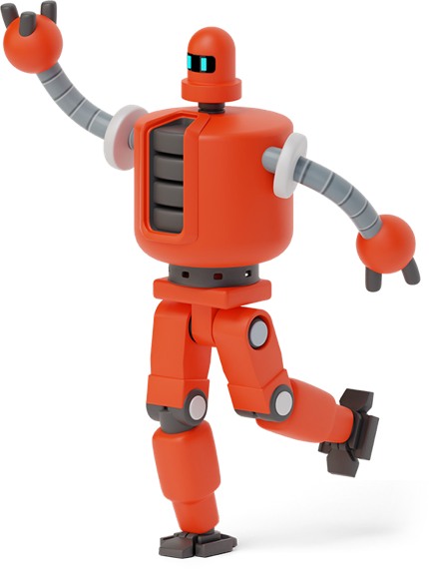
THE AI JOURNEY: FROM TURING TO TODAY
3
Discovery, Development, & Deployment
Notes:
Time to switch gears and instead of talking about all of the problems we face in social services, I’m going to introduce some possible solutions that will hopefully add new tools to your toolkit.

Slide 19
AI Roadmap
1950: Turing Test Conceived – Alan Turing proposes the idea of a machine's ability to exhibit intelligent behavior.
1997: Deep Blue’s Victory – IBM's Deep Blue defeats world chess champion Garry Kasparov.
2018: BERT– Release of Google's BERT, enhancing language understanding in LLMs with better context processing.
1950
1997
2018
1956
2015
2022
1956: Dartmouth Conference – The term 'Artificial Intelligence' is formally introduced and defined.
2015: Transformer Models – This new development allows LLMs to understand the context within text by focusing on relevant parts of a sentence during processing.
2022: ChatGPT by OpenAI – OpenAI launched ChatGPT, demonstrating advanced conversational abilities in AI.
Notes:
Let's embark on a brief journey through AI's history. From the theoretical underpinnings laid by Alan Turing to today's advanced neural networks, we've witnessed an astonishing rate of progress. And now, we stand on the brink of a new era with AI and our interaction with technology. It’s impressive to me how much progress has been made in just the last 10 years alone.

Slide 20
AI Hierarchy
Transformers
LLM’s
GPT’s
Notes:
Over the next few slides, we’ll be diving into the current technologies powering the current AI revolution including Transformers, Large Language Models, and Generative Pre-trained Transformers.
Transformers are a type of AI architecture designed to process sequences of data, like text, by paying attention to the relationships between elements regardless of their distance from each other. This makes them excellent for understanding and generating human language. Large Language Models (LLMs) are built on top of architectures like transformers and are trained on vast amounts of text, enabling them to comprehend and produce language with remarkable nuance. GPTs (Generative Pre-trained Transformers), a subset of LLMs developed by OpenAI, specifically leverage the transformer architecture to generate text that is coherent and contextually relevant, making them incredibly versatile for a wide range of natural language tasks. Together, these technologies represent a significant leap in AI's ability to interact with and process human language.
***END OF NOTE***

Slide 21
Linguistic Transformers: Rolling Out Revolutionary Tech
Transformers are a type of AI architecture designed to understand and generate human language by processing words in relation to all other words in a sentence, enabling more nuanced text interpretation and creation.
Picture generated with AI
Notes:
In the digital realm of AI, we often talk about transformers, but not the kind that you might remember from Saturday morning cartoons. There’s just one nod to our nostalgic past here – think of transformers as the smart, language-savvy cousins to Optimus Prime. They’re designed to process words in context, reshaping sentences with precision to create text that's remarkably human-like in its understanding and nuance. Now, while I can't showcase the actual Transformers for copyright reasons, I used their essence to inspire an image generated by AI. And, in true transformer fashion, the artwork was crafted by describing the essence of these robots because, as we know, creativity finds a way even when we can't directly use copyrighted material.
***END OF NOTE***

Slide 22
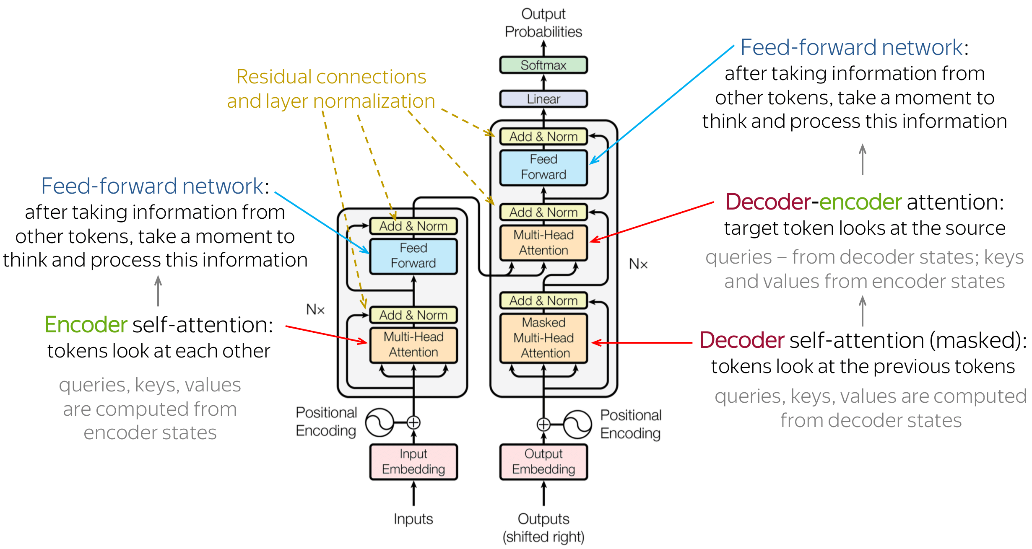
Transformer Architecture
More info at https://jalammar.github.io/illustrated-transformer/
Notes:
One way to think of a transformer is to imagine a DJ mixing tracks at a party. The DJ doesn't just play songs one after the other; they blend them together, adjusting the mix based on the vibe of the crowd, the energy on the dance floor, and the flow between songs. Transformer architecture in AI works in a somewhat similar fashion but with words and sentences.
When we communicate, our sentences are like a music playlist, where each word has its beat, and the overall message depends on how these beats come together. Transformers analyze the entire 'playlist'—the sentence or paragraph—all at once. They use something called "attention mechanisms," which is like the DJ’s skill in figuring out which tracks (or words) will vibe well together to maintain the energy (or meaning) of the conversation.
This means when you ask the AI a question or for a story, it doesn’t just consider your words in order but looks at them all together, understanding how they relate to each other, much like a DJ reads the room to know what song to play next. This helps the AI generate responses that are not just relevant but also coherent and contextually rich, ensuring the conversation keeps flowing smoothly, just like a well-curated music set.
For a deeper technical dive, I recommend visiting the link on the slide.
***ONLY IF SOMEONE ASKS***
Feed-forward Network:
It's like a one-way street where information moves straight from the start to the end, getting changed a bit at each step, sort of like passing a note in class that gets added to by each person it passes.
Encoder:
Imagine you have a secret message. The encoder is like a gadget that turns your message into a secret code, making sure all the important bits are ready to be understood in a new way.
Residual Connections and Layer Normalization:
Residual connections are like shortcuts in a maze, letting you skip some paths to get to the end faster. Layer normalization is like making sure everyone in a race starts from the same line, keeping things fair.
Decoder-Encoder:
This combo is like having a secret decoder ring. First, you encode (or scramble) your message, and then someone else uses the decoder to turn it back into something understandable.
Decoder:
The decoder is the part of the decoder ring that takes the scrambled message and turns it back into something you can read, like translating a secret code.
Position Encoding:
Imagine standing in a line where everyone is blindfolded. Position encoding lets you know exactly where you stand in the line, even if you can't see.
Input Embedding:
This is like turning your words into a special code that a computer can understand, sort of like translating your language into computer language.
Output Embedding:
After the computer has worked on solving a problem, output embedding turns the computer's solution back into words we can understand.
Add & Norm:
This is about adding together information and then making sure it's not too crazy or too boring, kind of like adjusting the volume on your music to just the right level.
Multi-head Attention:
Imagine you're trying to solve a puzzle by looking at it from different angles at the same time. Multi-head attention lets a computer focus on many different parts of a problem all at once.
Feed Forward:
This is another way of saying things move in one direction, from start to finish, getting processed along the way—like going down a slide.
Softmax:
It's like deciding which slice of pizza to grab based on how good each piece looks, but mathematically ensuring you pick the best one.
Linear:
This is a fancy way of saying we're making a straight-line connection between two things, like drawing a line from point A to point B.
Masked Multi-head Attention:
It's like multi-head attention but with some parts hidden, so you're solving the puzzle without seeing the whole picture, making sure you focus only on the important pieces.

Slide 23
AI Unveiled: Six Transformative Technologies
Large Language Models (LLMs)
Generate and understand human-like text, powering tools like ChatGPT .
Machine Learning Platforms
Offer tools for building and deploying adaptive algorithms across various applications.
Robotic Process Automation (RPA)
Automate repetitive tasks by simulating human interactions with digital systems.
Computer Vision
Allow machines to interpret visual information from the world, akin to human sight.
Natural Language Processing (NLP)
Enable understanding and generation of human language for effective communication.
Neural Networks/Deep Learning
Mimic the human brain’s structure to analyze data and recognize complex patterns.
Notes:
Let's explore a hotbed of activity in the landscape of AI, which is as diverse as it is fascinating. Take Large Language Models, or LLMs, like the one I used to create this presentation, which excel at understanding and generating human language. Machine Learning Platforms are the toolkits for crafting AI models, while Robotic Process Automation, or RPA, streamlines our repetitive tasks. Computer Vision grants machines the gift of sight to interpret our world, and Natural Language Processing, or NLP, bridges human-AI communication gaps. Lastly, Neural Networks and Deep Learning are the engines of pattern recognition, driving forward innovation.
Each type of AI has transformative potential, ready to be unlocked across various fields and facets of life. All of these technologies use transformers, but we’re only going to focus on one particular transformer for the rest of this presentation, LLMs.
***END OF NOTE***

Slide 24
Information extraction
Structured data
Large Language Model (LLM)
Instruction following
Text
Object recognition
Training
Adaptation
Image captioning
Voice & Audio
Q&A
3D signals
Sentiment
analysis
Images
Notes:
Large Language Models (LLMs) harness the power of transformer technology to analyze information and craft text that makes sense in context. Just like the brain's network of neurons, LLMs form a complex web within computers, learning from massive data to understand and mimic human conversation. This is the type of AI the rest of this presentation will primarily focus on.
***END OF NOTE***

Slide 25
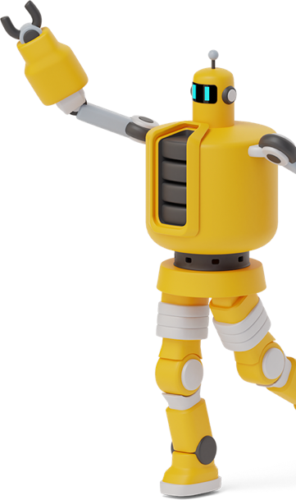
LLMs: Pioneers of Next-Gen Communication & Understanding
GPT-4
OpenAI's latest marvel, offering human-like text generation with nuanced understanding and broader knowledge.
BERT
Google's continually evolving model, adept at deciphering the intent behind words for better search and interaction.
T5
Google's comprehensive text-to-text framework, turning language tasks into a uniform approach for superior performance.
RoBERTa
Facebook's enhanced BERT variant, achieving state-of-the-art results in language understanding with refined training techniques.
XLNet
Advanced permutation-based learning, enabling deeper contextual comprehension over a wide range of language tasks.
ERNIE
Baidu's semantic powerhouse, fusing language with knowledge graphs for richer, more accurate language models.
Notes:
Here’s a list of popular LLM’s.
Large Language Models, or LLMs, are at the cutting edge of AI, transforming how we communicate with machines and access information. They understand, generate, and interact with human language in profound ways. GPTs are a subgroup of LLMs, and for the rest of this presentation, we’ll be working exclusively AI chatbots.
***END OF NOTE***

Slide 26
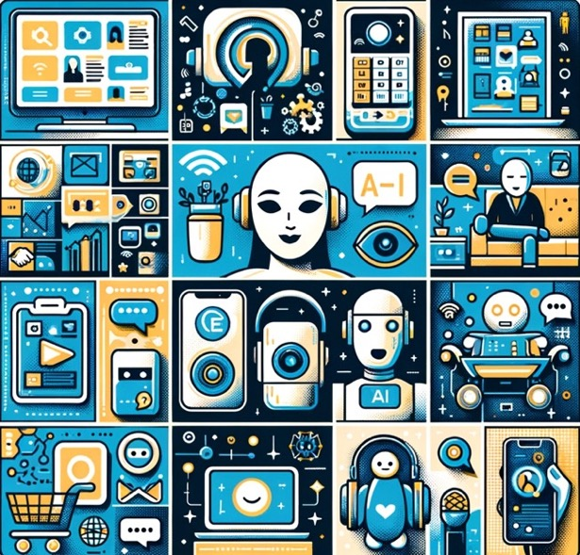
AI is weaving invisible threads through everyday life
AI shapes our daily digital experiences, from morning greetings by voice assistants to personalized recommendations.
Picture generated AI
Notes:
Today, AI is not a distant concept; it's woven into the fabric of our daily lives. From the voice assistant that greets us in the morning to the recommendations that guide our choices, AI's subtle yet profound influence is ever-present, shaping our digital experiences.
***END OF NOTE***

Slide 27
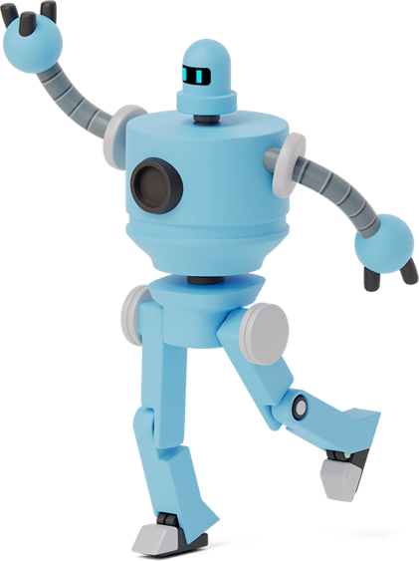
THE AI ASSISTANT: A Revolution in Resource Management
4
Efficiency, Improvement, & Replicability
Notes:
Now we’ll dive into how At chatbots elevate operational efficiency, foster continuous improvement, and allow for successful strategies to be replicated across the social services landscape, ensuring quality and scalable impact.
***END OF NOTE***

Slide 28
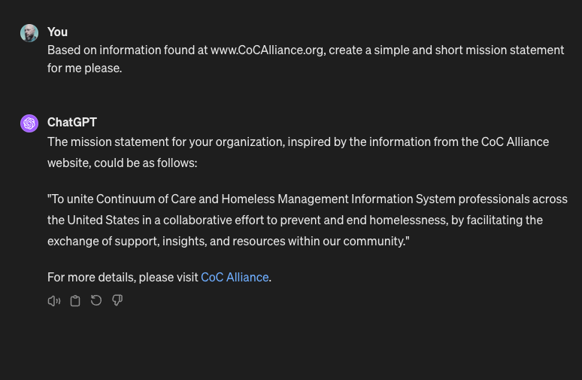
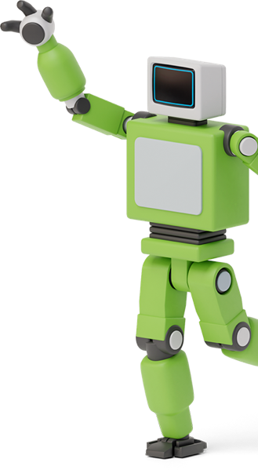
Creating Solutions with AI
GARP
AI can make mistakes. Consider checking important information.
Notes:
AI chatbots are not your ordinary chatbots. They are a sophisticated blend of technology and language, designed to converse with nuance and understanding. As we interact with them, we're not just talking to machines; we're engaging with systems that learn from every exchange.
There are many free and paid versions of AI chatbots online, but we will avoid going to deep into any specific vendor today.
***END OF NOTE***

Slide 29
AI Chatbot vs. Dumb Chatbot
Adaptability
AI chatbots learn and evolve; regular chatbots follow fixed programs.
Understanding
AI chatbots grasp language and context; regular chatbots need specific commands.
Personalization
AI chatbots remember and personalize; regular chatbots start anew each time.
Efficiency
AI chatbots manage complex tasks; regular chatbots handle simpler tasks.
Intelligence
AI chatbots analyze and predict; regular chatbots do not.
Independence
AI chatbots self-improve; regular chatbots require manual updates.
Notes:
AI chatbots represent a paradigm shift in digital interaction. They're not just programmed to respond—they're designed to understand, learn, and adapt, providing a personalized and efficient experience. Unlike their regular counterparts, AI chatbots bring a level of intelligence and independence to the table, fundamentally changing the way we engage with technology.
***END OF NOTE***

Slide 30
“Our intelligence is what makes us human, and AI is an extension of that quality.” -Yann LeCun
Notes:
Let’s dive into the dynamic world of AI chatbots and explore how these AI can be powerful digital allies. Whether you're streamlining internal processes, enhancing client engagement, or sparking innovation, AI chatbots stand ready to revolutionize the way we work. Today, we'll uncover the practical applications of AI chatbots that can benefit both individuals and organizations alike.
**END OF NOTE***

Slide 31
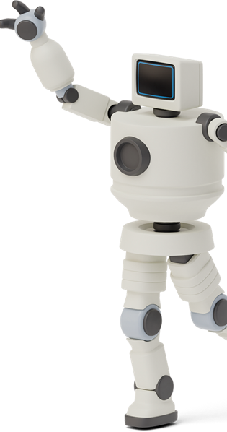
Empowering Social Impact: AI in Action
Internal Documentation
Quickly create and update key organizational documents for clear internal and external communication.
Marketing and Outreach
Generate engaging digital content to boost awareness and community engagement with ease.
Grant Writing
Streamline proposal creation to secure essential funding more efficiently.
Educational Resources
Develop tailored training materials for staff and community education.
Client Support
Deploy AI for instant responses to common queries, enhancing service accessibility.
Advocacy Efforts
Craft impactful policy briefs and advocacy materials with AI-assisted research and writing.
Notes:
As we delve into the potential of AI chatbots for our organization, we uncover avenues to amplify our impact and streamline our operations. Starting with internal documentation, AI chatbots enable us to effortlessly craft and maintain essential documents, ensuring our team shares a unified vision and voice. In the realm of marketing and outreach, these powerful tools assist us in creating compelling content that resonates with our community, elevating awareness and engagement. When it comes to securing funding, AI chatbots simplify the grant writing process, allowing us to articulate our mission and needs more effectively to potential funders. Education is at the heart of empowerment, and with AI chatbots, we're able to produce tailored training materials that enrich our staff and volunteer base, as well as educate the community we serve. For client support, implementing AI chatbots offers immediate assistance to those we aim to help, making our services more accessible. Lastly, in our advocacy efforts, AI chatbots are an invaluable ally, helping us to research and draft policy briefs and advocacy materials, amplifying our voice in the fight to prevent and end homelessness. Each of these applications of AI chatbots not only enhances our efficiency but also magnifies our impact, bringing us closer to achieving our mission.
***END OF NOTE***

Slide 32
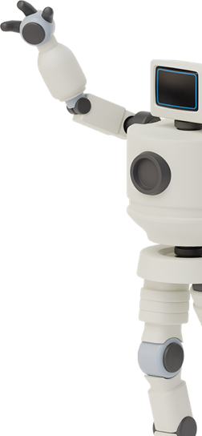
AI IMPACT: Transforming Data Management & Services
Automated Data Quality Checks
Ensure data integrity with automated assessments, reducing manual errors and streamlining compliance.
Dynamic Reporting
Effortlessly generate detailed reports from complex data sets, enhancing decision-making and transparency.
Custom Coding Solutions
Quickly develop and deploy code for bespoke software enhancements, improving system functionality and user experience.
Real-time Query Resolution
Provide instant answers to frequent queries, boosting administrative efficiency and user satisfaction.
Training & Educational Content Creation
Craft engaging, easy-to-understand training materials to elevate user competency and system utilization.
Predictive Analysis for Resource Planning
Utilize advanced analytics to forecast trends, aiding in proactive resource
allocation and service
planning.
Notes:
AI chatbots can be a game-changer for administrators across the board, not just in HMIS but in any data-intensive environment. By automating data quality checks, AI chatbots ensure our databases are both accurate and compliant, laying a solid foundation for reliable reporting. They streamline the creation of dynamic reports, turning data into actionable insights. With custom coding solutions, we can tailor our systems to meet unique needs, enhancing overall functionality. AI chatbots also revolutionize how we handle queries, providing immediate, accurate responses that keep operations smooth. It's not just about data management; they are also tools for empowering our teams with tailored training materials, ensuring everyone can leverage our systems to their full potential. And with predictive analysis, we're always one step ahead, ready to allocate resources effectively and meet our communities' needs. AI chatbots aren't just enhancing our work; they're redefining efficiency and effectiveness in our field.
***END OF NOTE***

Slide 33
The AI Advocate: AI Chatbots’ Practical Impact on Social Missions
5
Empathy, Innovation, and Efficiency
Notes:
Now that we’ve given some ideas about how AI chatbots can be used in social services, let’s explore some specific examples.
***END OF NOTE***

Slide 34
GARP
Gaither’s
Assistant &
Robotic
Person
Notes:
For the rest of the presentation, I will be referring to the AI chatbot that I used as Gaither’s Assistant & Robotic Person, or GARP. To find an AI chatbot to use for your presentations, search online for AI chatbots.
***END OF NOTE***

Slide 35
Prompt engineering
How to guide AI models towards producing specific, desired outputs efficiently
Notes:
Before we begin with our examples, we must cover prompt engineering first. Prompt engineering is the art of crafting questions or statements to get the best possible response from an AI chatbot, like me asking GARP to write a story or solve a math problem. For example, instead of saying "Talk about Napoleon," you might say, "Describe Napoleon Bonaparte's impact on European history," to guide the AI towards a more focused and informative reply. This method ensures that your GARP’s responses are more aligned with the user's needs, making interactions more efficient and effective.
***END OF NOTE***

Slide 36
Prompt Engineering: Basic components
Roleplay
Assigning a specific perspective or identity to the AI to shape its responses, like pretending it's an expert in a certain field.
Add Context
Providing background information to help the AI understand the situation or topic better, ensuring more relevant responses.
Task or Question
Clearly stating what you need from the AI, whether it's solving a problem or answering a question.
Provide Example
Including examples in your prompt to guide the AI's output, showing rather than just telling what you're looking for.
Current Output
Referring to the AI's previous responses as a foundation for further questions or refinement, creating a more coherent interaction.
Output Format
Defining how you want the AI's response to be structured, whether as a list, a detailed explanation, or a brief summary, to meet your specific needs.
Notes:
Let's dive into the nuts and bolts of prompt engineering, a technique that allows us to 'direct' GARP’s responses more precisely. It's like giving an actor a role to play – for instance, asking the AI to respond as a climate scientist brings a focused expertise to its answers. We also set the scene by adding context, enriching the AI's understanding of the topic. It's crucial to ask the right questions or set clear tasks – whether you're seeking advice or solutions. Think of it as instructing a detective; the more specific the question, the better the lead they can follow. And examples? They're the blueprints for the AI, illustrating exactly what we want to see in the output. Finally, by specifying the output format, we can determine how the response is presented, whether as a concise list or a detailed narrative. This structured approach can turn a simple AI interaction into a powerful tool for achieving specific outcomes, much like how a script shapes a film.
***END OF NOTE***

Slide 37
Prompt Engineering: The Anatomy of a Prompt
Imagine you're the marketing director for a local homeless coalition.
We are currently looking for volunteers to help work in our local
cafe where we serve breakfast, lunch, and dinner to people experiencing
homelessness locally.
Write me a short social media post to help me get volunteers.
Look online for examples similar to what I want.
Add emoticons and make it family friendly and compassionate.
Role
Context
Task
Example
Output
Notes:
Here are the various components of an effective prompt with specific examples.
***END OF NOTE***

Slide 38
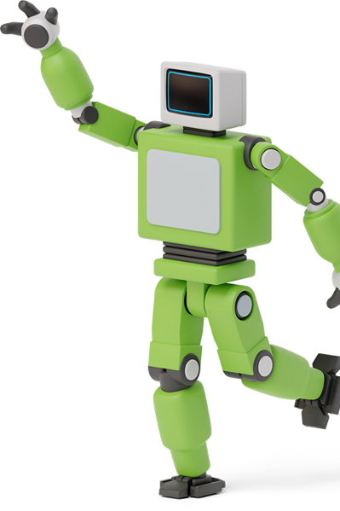
AI OUTPUT
🌟 Calling all big hearts! 🌟 Our community cafe is more than just a meal service; it's a beacon of hope for those facing homelessness. We're in urgent need of compassionate volunteers for breakfast, lunch, and dinner shifts. 💖 Your time can turn a day around for someone in need. Join us in making a difference, one meal at a time. 🍽️✨ Family-friendly and filled with gratitude, every helping hand brings us closer to a world where no one goes hungry. Interested? DM us today! #VolunteerWithUs #CommunityCafe #MakeADifference
Notes:
Here’s the output from our simple prompt!
***END OF NOTE***

Slide 39
Example #1
How to use AI chatbots to create mission, vision, and value statements, marketing materials, and more!
Notes:
Our first example involves using GARP to craft various organizational statements for us, but we’re going to cheat a little. I’ll explain in a moment.
***END OF NOTE***

Slide 40
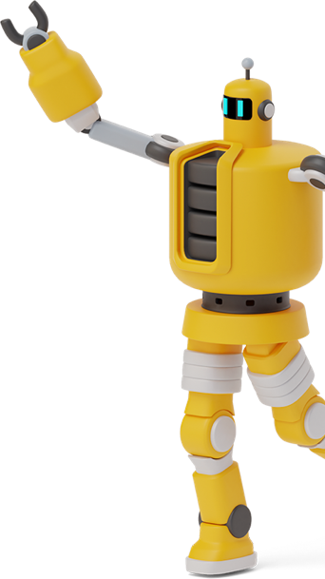
Prompt Shortcut: Get AI to do the heavy lifting
Purpose & Impact
Define the organization's central purpose and the impact it seeks to make.
Community & Outreach
Describe the community served and the approach to outreach and service.
Values & Principles
Outline the core ethical considerations and principles that guide the organization's decisions and actions.
Goals & Aspirations
Specify both short-term objectives and long-term aspirations of the organization.
Differentiators
Identify what sets the organization apart from others, such as unique methodologies or services.
Cultural & Ethical Stance
Express the organization’s stance on important cultural, social, and ethical issues.
Notes:
When creating a prompt from scratch, it’s important to cover the basics and give your GARP the information it needs to craft it into a useable components. You can do this by typing directly into the chat interface, or if you have a website, you can have your GARP get the information for you if it has that capability!
***END OF NOTE***

Slide 41
AI Chatbot Pro-Tip: Self-Generated Prompts
Give me a prompt to use with an AI chatbot that covers role, context, task, example, and output format. Pretend you are a marketing professional at the Charlotte County Homeless Coalition. Create a prompt that person might use to develop a mission statement, a vision statement, and value statements. Visit CCHomelessCoalition.org for information to use.
Notes:
By ”cheating”, we can ask GARP to generate the prompt we’ll use to get a good response.
***END OF NOTE***

Slide 42
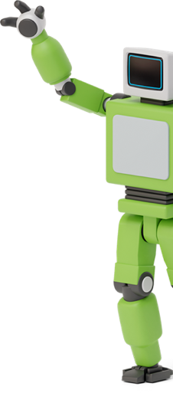
AI Generated Prompt to create ORGANIZATIONAL statements
Using the detailed information about our organization's efforts and impact available on CCHomelessCoalition.org, craft a mission statement that encapsulates our role in providing support and creating systematic change for the homeless population in Charlotte County. The mission statement should reflect our hands-on approach and dedication to advocacy. Furthermore, develop a forward-looking vision statement that articulates our commitment to a future where homelessness is not only alleviated but also prevented. Lastly, compose a series of value statements that convey our core principles, including compassion, collaboration, respect, and innovation. Each statement should be presented in a bullet-point format, precise and inspiring, to guide our internal decision-making and communicate our ethos to the community and stakeholders.
Notes:
Here is the prompt that GARP created to use as a prompt for itself.
***END OF NOTE***

Slide 43
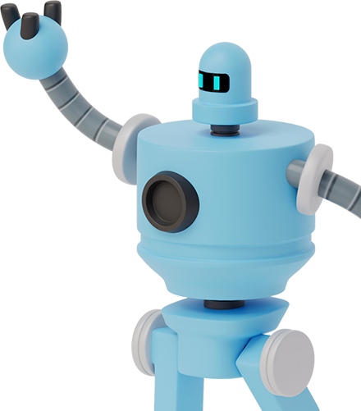
Mission Statement
"The Charlotte County Homeless Coalition is dedicated to the eradication of hunger and homelessness in our community through a proactive blend of direct aid and systemic change. We offer emergency shelter, food, and support services to those in need, while also enabling stability through utilities, rent, and employment assistance. We stand committed to guiding our clients towards self-sufficiency and permanent housing, ensuring that no one has to face the perils of homelessness alone.
Notes:
Here’s our generated mission statement.
***END OF NOTE***

Slide 44
Vision Statement
"Our vision is a future where homelessness and hunger in Charlotte County are not just addressed but prevented. We strive for a community where every individual has access to stable housing, adequate nutrition, and the opportunity for economic independence. We believe in a tomorrow where our interventions and preventative strategies create a sustainable foundation for long-term community resilience.
Notes:
Here’s our vision statement.
***END OF NOTE***

Slide 45
Value Statements
Compassion: We approach our work with empathy, always recognizing the inherent dignity of every individual we serve.
Collaboration: We believe in the power of unity, working alongside our community and partners to foster impactful solutions.
Respect: Every interaction is grounded in respect, honoring the experiences and challenges faced by those we aid.
Innovation: We are committed to seeking out and implementing creative solutions that drive progress in the fight against homelessness and hunger.
Notes:
Here are our value statements. This took about 30 seconds to generate all statements, mission, vision, and value.
***END OF NOTE***

Slide 46
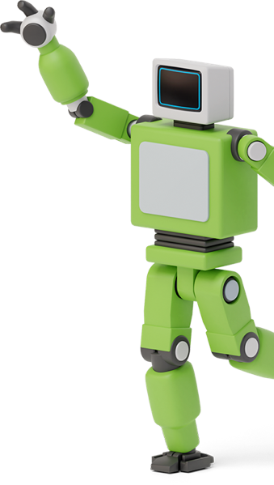
30 more AI CHATBOT Use cases
Mission statements
Vision statements
Value statements
Social media posts
Press releases
Newspaper copy
Radio scripts
Grant Proposals
Donor thank-you letters
Educational materials
Blog posts
Email campaigns
Case studies
Op-eds
Annual reports
Client testimonies
Brochure/flyer content
Training materials
Job descriptions
Policies and procedures
Policy advocacy letters
Newsletter content
Scriptwriting
Speech writing
FAQs
Website content
Program descriptions
Executive summaries
Interview questions
Surveys
Notes:
This slide showcases 30 additional ways organizations can leverage AI chatbots, spanning marketing, customer service, content creation, and operational support. It underscores the versatility of AI in enhancing efficiency, creativity, and engagement across various organizational functions. AI chatbots’ ability to generate diverse content types highlights their potential as a valuable tool in any organization's digital strategy arsenal.
***END OF NOTE***

Slide 47
80/20 Rule
This is a good work ratio between AI and the user
Notes:
AI chatbots play a pivotal role, like diligent assistants, doing most of the grunt work in your projects. If you find yourself sweating over the details, it's time to re-evaluate your prompts to let your GARP shoulder more of the burden. By hitting the sweet spot of an 80/20 workload distribution, you'll notice a significant cut in your project time—potentially saving 80% of it. Just remember, your expertise is crucial for that final 20%—always review the work of AI chatbots, adding your touch to ensure accuracy and quality before anything goes public.
***END OF NOTE***

Slide 48
Example #2
How to use an AI coding assistant for data ETL
Notes:
I encountered a challenge in a personal project: my bank only provided PDF downloads, not raw data. With GARP's assistance, I installed Python, extracted the necessary data from the PDF, and transformed it into a structured format. Finally, I loaded this curated data into a text file, ready for further manipulation. Now, let's dive into the details!
***END OF NOTE***

Slide 49
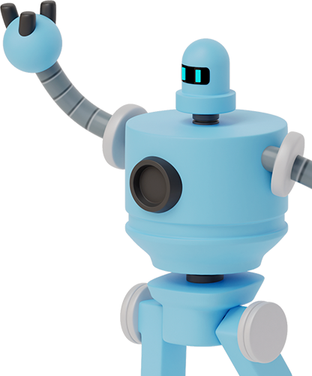
Custom AI
By creating a custom AI such as a Generative Pre-trained Transformer (GPT) and pre-loading it with your specific documentation libraries, you effectively craft a highly specialized subject matter expert. This AI can understand and interact based on the nuanced information and context unique to your work or personal needs. It becomes a tailored assistant, proficient in your domain, capable of providing insightful responses, generating relevant content, and assisting with tasks by drawing directly from a curated knowledge base you provide, making it an invaluable resource for efficient and informed decision-making.
Notes:
Unlike the last example where I simply used my AI chatbot’s web interface, for this example I created a more powerful customized version of GARP. Many AI chatbots use proprietary technology and paid services, for advanced topics like creating your own custom AI chatbot or for a deep dive into custom GPT’s, please use your favorite search engine. There are open-source options as well, but I’m not as well versed in those yet. In fact, I’m wondering if anyone in the audience had had any experience with open-source AI?
***END OF NOTE***

Slide 50
6 advantages of using a custom AI Chatbot
Enhanced Accuracy
Tailors the model's responses to your specific domain, improving accuracy.
Personalized Experience
Creates a unique AI that understands your context and needs.
Customized Learning
Tailors AI to learn from your specific content, leading to more accurate and relevant responses.
Efficiency
Streamlines workflows by automating tasks aligned with your operational specifics.
Knowledge Consolidation
Centralizes scattered information into a single, accessible AI resource.
Innovation
Enables novel applications of AI tailored to niche or innovative use cases that can be shared with others.
https://bradyim.substack.com/p/how-to-build-your-own-custom-gpt
Notes:
Alright, let’s check out something pretty cool – the six big wins of using a custom AI chatbot. First up, we're talking Enhanced Accuracy. Imagine an AI that gets you, really gets your domain, and delivers spot-on answers. That's what we're aiming for.
Then, there's the Personalized Experience. It's like having a chat with a friend who knows exactly what you're about and never misses a beat. Customizing an AI chatbot is all about tailoring its know-how to fit your unique needs.
Moving on to Customized Learning – this is where it gets even smarter, learning from your own content. It's like feeding it a diet of your finest data, making it more relevant and insightful every day.
Efficiency is a game-changer. Think less grunt work, more genius work. It's about automating the mundane so you can focus on the creative and critical.
Knowledge Consolidation is your information powerhouse. It's about having all your scattered info in one place, ready at the tap of a key.
And last but certainly not least, Innovation. This is where the magic happens, pushing boundaries, exploring new frontiers, and coming up with solutions that are as unique as they are effective.
So, in a nutshell, customizing an AI chatbot is like having a super-smart, super-efficient, and super-personal assistant who's always on the ball. Pretty exciting stuff, right?
***END OF NOTE***

Slide 51
Using Custom AI Chatbot for Code generation Overview
1. Install Python
Ask AI for instructions on installing Python for your desired work environment.
2. Troubleshoot Installation
Address any installation issues with AI’s assistance.
3. Install Libraries
Follow AI’s instructions to install additional Python libraries that might be needed.
4. Script Development
Get help from AI to refine or write a Python script that reads the text from the PDF and identifies transaction data.
5. Data Structuring
Use AI to improve the script to organize the extracted text into a structured format, like CSV, separating dates, descriptions, and amounts.
6. Data Preparation
Ensure the CSV file is ready for analysis, potentially using Python for initial data cleaning or analysis.
Notes:
In tackling my personal project, I first set up Python with clear instructions from my custom GARP. Encountered some installation challenges, but resolved them with my GARP's guidance.
Next step was installing additional Python libraries. GARP provided the necessary details, streamlining the process.
Developing the script was collaborative. With GARP's assistance, I refined a script that extracts transaction data from a PDF and shapes it into a structured format.
The following stage involved structuring the data into a CSV file. GARP and I worked together to ensure the data was organized with appropriate categories for dates, descriptions, and amounts.
The final step was data preparation, cleaning, and getting the CSV file analysis-ready, again utilizing Python and GARP's input for efficiency.
Throughout the project, GARP was a valuable resource, enhancing the development process.
***END OF NOTE***

Slide 52
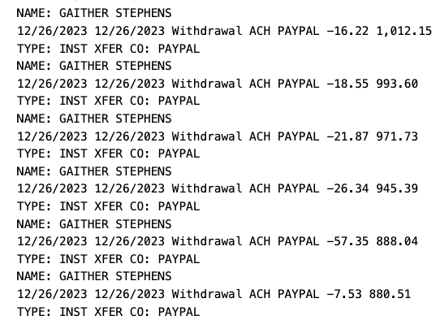
PDFtoText Bank Statement
Notes:
I needed to convert the content of a PDF into a text format for data manipulation. The initial text output was disorganized and unclear. After reviewing various PDF-to-data conversion options, I found that they were either too expensive or resulted in unusable, disordered data that required extensive effort to refine. Once Python was installed, I engaged GARP's assistance to sort through the disorganized text.
***END OF NOTE***

Slide 53
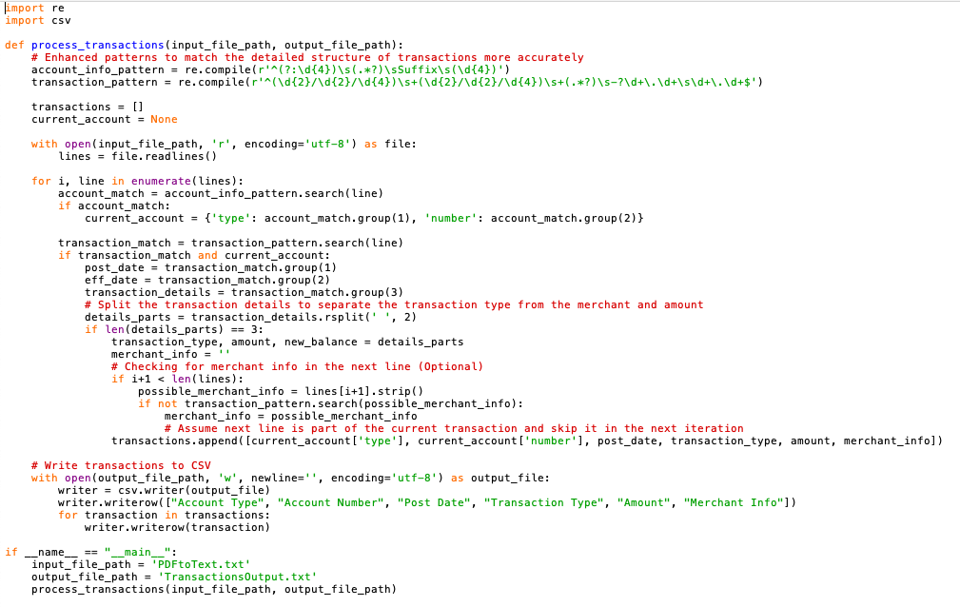
GARP Generated Python Script
Notes:
I built my custom GARP, loaded my PDFtoText file into it so that GARP could always reference the underlying data, and then began the task of asking GARP to convert the PDFtoText file to a format that was easier to modify such as having field names such as Account, Amount, Date, etc.. I would ask GARP to create a script to transform my data, then I would take the output, feed it back into GARP with the new instructions, and then GARP would give me new code to try, rinse, repeat!
***END OF NOTE***

Slide 54
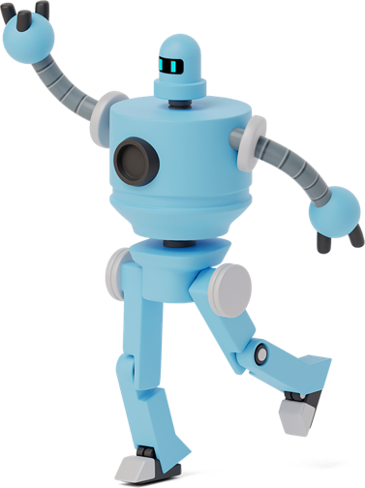
Iterative PROMPTING strategy for AI
03
AI OUTPUT
New code to try
AI INPUT
Current instructions
Current code
Current output
01
02
PROMPT MODIFICATION
Examine output
Modify instructions
Notes:
I adopted an iterative development process for my Python script, where I incrementally enhanced the code. In each cycle, I provided GARP with the most recent version of the code, its corresponding output, and specific instructions for the next iteration. This method effectively minimized deviations and focused on resolving distinct issues within the code. The result was a high-quality output achieved efficiently. While my project is not yet complete, primarily due to its evolving scope, I am actively planning more sophisticated developments for its future.
***END OF NOTE***

Slide 55
Python Script Output
Still a work in progress, as you can see there are no amounts yet, but by feeding the PDFtoText document (bank transaction data) into GARP, the current code, current output, and adjustment instructions, we can reach our desired output after several iterations of this process.
Notes:
The iterative process I've been using to develop my Python script with GARP's help has proven quite effective. I've invested roughly an hour into this project, which is a significant improvement compared to the week-long efforts such tasks demanded in the past. The iterative key is simple: supply GARP with the last script output and specify the desired changes. The more precise and intentional the information provided to GARP, the better the outcomes. Each time I request refinements, I ensure GARP has access to the initial PDF-to-text output, the current instructions for the task at hand, and the existing code that needs improvement. This disciplined approach maintains focus and has been successful for me over the past year while using GARP for various projects.
***END OF NOTE***

Slide 56
Example #3
How I used GARP to create this NHSDC presentation (advanced prompt engineering)
Notes:
The next example is more of a lesson in advanced prompting.
***END OF NOTE***

Slide 57
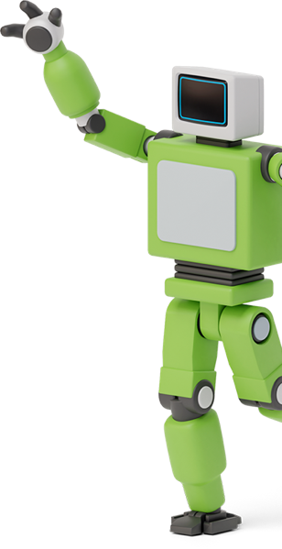
AI Chatbot Pro-Tip: Self-Generated Prompts
Hello, we are going to be creating a presentation for me to give at a conference.
This is how the instructions are formatted.
Current instruction set for presentation.
Current presentation in the format:
Slide Number
Slide Content and description.
Slide Note to be read out loud by me.
Notes and documents.
Static instructions to always keep in mind.
Notes:
Let's talk about streamlining our workflow with a script-based approach. By continuously integrating our latest output alongside new directives for enhancement, we keep our AI assistant, GARP, on track—this is crucial to prevent any 'drift' from our original intent. In the next segment, we’ll explore common pitfalls when working with AI like GARP and how to avoid them. During the creation of this presentation, I applied this iterative method, using a Word document to compile and refine content with the help of GARP.
***END OF NOTE***

Slide 58
AI mastery: Essential Strategies for success
6
Tips, Tricks, & Cautions
Notes:
AI are great, but there’s still so much to learn!

Slide 59
AI Chatbot Prompts to get you started
Explain like I’m…
Explain [topic] to me like I’m [age] years old.
Start at the beginning
I am a social worker, and I am new to AI. Can you give me a list of prompts that help me get stuff done?
80/20 Learning
I want to learn about [topic]. Identify and share the most important 20% of learnings from this topic that will help me understand 80% of it.
Learn a new skill
I wan to learn [subject]. I am a complete beginner. Create a 30-day learning plan that will help me learn and improve.
Consult an expert
I will give you a sample of my writing, I want you to criticize it as if you were [person]: [your writing]
Innovation
Enables novel applications of AI tailored to niche or innovative use cases that can be shared with others.
https://twitter.com/ingliguori/status/1704937794617901371
Notes:
Alright, let’s get into how to have a chat with an AI chatbot and get the most out of it!
So, you know how sometimes you need to explain things to kids, and you have to make it super simple? There's a prompt for that. Just say, “Explain [topic] to me like I’m [age] years old,” and voila, you’ll get explanations that are easy to grasp.
If you’re a social worker and new around here, welcome aboard! To get started, ask for a list of prompts by saying, “Can you give me a list of prompts that help me get stuff done?” It's like having a cheat sheet for all your tasks.
Now, if you’ve heard of the 80/20 rule, it’s like finding the golden nuggets of information. Ask, “I want to learn about [topic]. What's the 20% that’ll help me understand 80% of it?” This is perfect for getting the lowdown without all the fluff.
Looking to level up a new skill? Ask your AI assistant to set you up with a “30-day learning plan for [subject].” It’s like having a personal trainer for your brain.
Got some writing that you want a second opinion on? Toss it over by saying, “Here's my writing. Give it to me straight, or as if you were [famous critic].” It’s like having a coach who’s also a bit of a cheerleader.
And for the innovators out there, if you’re looking to push boundaries, ask how AI can do just that with, “How can AI enable innovation in [your field]?” It’s like brainstorming with a supercomputer.
So, go ahead and give these prompts a try. Think of an AI chatbot as your friendly neighborhood helper, always up for a good chat and ready to lend a hand!
***END OF NOTE***

Slide 60
AI Tips & Tricks from experience
Multiple Options
AI can be limited by the number of interactions with it during a time frame. Rather than asking for 1 suggestion at a time, ask for 30.
Separate Instructions
Keep instructions in a text document so you can more easily review, refine, and resubmit them.
Use a Custom AI
If you have a long-term project that you need expertise from, build a custom AI to help.
Ask Advice
If you have a question in your head, ask AI using natural language, and ask for suggestions on how to deal with it.
Start Over
Occasionally, AI may deviate from initial instructions. To realign, review and resend your original directions in a condensed form.
Double Check
Always read every word that AI generates and double check everything for accuracy.
Notes:
Okay, so an AI chatbot can be a bit like a genie in a bottle – you've got a limited number of wishes... I mean, interactions. To make the most of it, don't just ask for one idea; go big and ask for 30 at once. Boom, you’ve got options!
Now, about keeping things organized, it’s like keeping a recipe handy while cooking. Store your instructions in a doc. This way, you can tweak them, just like perfecting your grandma’s secret sauce recipe, and then serve them up to your AI chatbot again.
And say you’re building something big, like a treehouse that’ll last for years. You might want a custom toolbox, right? The same goes for projects with AI chatbots – consider building a custom AI chatbot that fits just right.
Stuck on something? Just chat it out with your AI chatbot. Ask like you're asking a pal for advice, and don’t forget to be specific – it’s like asking for the best route to your favorite ice cream shop.
But what if your AI chatbot starts getting off-track, like when your dog spots a squirrel on a walk? No stress. Just rewind, simplify your instructions, and toss them back, like reminding your pup you’re on a walk, not a squirrel chase.
Last tip – double-check your AI’s work, like you'd proofread a text before sending it to your crush. You want to make sure every 'i' is dotted and every 't' is crossed for accuracy.
So, that’s the scoop! AI are here to help – just keep these tricks up your sleeve, and you’ll be chatting up a storm in no time.
***END OF NOTE***

Slide 61
AI Pitfalls: Understanding the Challenges
🎈
Misinterpretations
Sometimes, AI may not fully grasp complex prompts, leading to irrelevant responses.
Data Privacy Concerns
Sharing sensitive information poses a risk as the model can't ensure data privacy.
Context Inaccuracy
AI might generate plausible but incorrect information, requiring fact-checking.
Bias in Responses
The model can inadvertently reflect biases present in its training data.
Dependence on Internet
AI requires an internet connection, limiting access in offline scenarios.
Hitting Usage Limits
High demand can lead to hitting usage quotas, restricting access to the service.
Notes:
Getting close to the end, let’s talk about the fine print when it comes to using AI. It’s like embarking on a new adventure – exciting, but you gotta watch out for those hidden pitfalls!
First off, let’s chat about misinterpretations. It’s like trying to read someone’s mind – you gotta be crystal clear with your prompts to get the response you want from AI.
Then there’s the biggie – data privacy. Just like keeping your secrets safe with your best friend, be cautious about sharing anything too personal with the model.
Now, onto accuracy. Think of an AI chatbot like a trivia master – sometimes spot-on, sometimes a bit off. So, it’s always good to double-check any important info it gives you.
And biases? Yep, even AI isn’t immune. It’s like looking at the world through someone else’s glasses – there might be a slight distortion. So, take what it says with a pinch of salt and trust your own judgment.
Oh, and don’t forget the need for an internet connection. It’s like having your phone charged before a road trip – gotta be prepared for any unexpected detours.
Lastly, hitting those usage limits. It’s like trying to cram too much into your suitcase – sometimes you gotta prioritize and pack smart to make the most of AI without any hiccups.
So, while AI is an amazing tool, let’s keep these points in mind to make our journey with it as smooth as possible!
***END OF NOTE***

Slide 62
Navigating AI Pitfalls: Practical Considerations
🎈
Misunderstanding Nuance
Subtleties of language or humor might not be accurately captured or generated.
Over-reliance on AI
Excessive dependence might hinder critical thinking and problem-solving skills.
Response Drift
AI might stray from the original instructions or topic over extended interactions.
Downtime & Accessibility
Scheduled maintenance or unexpected outages can make the service temporarily unavailable.
Ethical & Legal Risks
Using AI-generated content in sensitive or regulated areas might pose ethical or legal challenges.
Feedback Loop Risks
Incorrect or biased feedback can reinforce unwanted behaviors or outputs in the model.
Notes:
Continuing with AI pitfalls, dealing with AI's struggle to fully grasp nuances and subtleties in language emphasizes the need for us to review and sometimes adjust the generated responses to better fit the intended context.
The potential for over-reliance on AI technology raises an important point about maintaining a balance; it's essential not to let it overshadow our own creativity and problem-solving skills.
Response drift, where AI may stray from the initial instructions, can be managed by periodically clarifying or refining our prompts. The occasional downtime and accessibility issues remind us of the importance of having backup strategies or alternative resources ready.
Ethical and legal risks associated with using AI-generated content in sensitive or regulated domains advise us to seek appropriate guidelines or legal counsel.
Finally, the risk of feedback loops reinforces the need for providing accurate and unbiased feedback to AI chatbots, helping improve the model's reliability and relevance over time.
***END OF NOTE***

Slide 63
Thanks!
Any questions? You can find me at:
@GaitherStephens
Gaither.Stephens@GaitherDyn.com
Notes:
I’ll take any questions now.
***AFTER QUESTIONS***
Thank you for being here, thank you to the NHSDC for allowing me to present, and feel free to reach out to me after the presentation!
***END OF NOTE***

